Slide 1
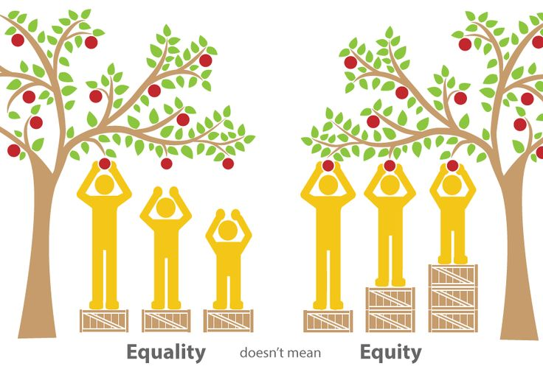

Student Equity Plan Review
SEW, Fall 2016

Slide 2
Student Equity Plan Success Indicators
Access
ESL, Math, English Basic Skills Completion
Course Success/ Completion
Degree and Certificate Completion
Transfer

Slide 4
Major accomplishments
Direct Support for Students - Book Vouchers
Professional Development
Early Alert Program
FYE and UMOJA Programs
Online Access to Data (beta)
Discussions across campus – SLO Committee, Assessment Taskforce, PRC, OPC, Transfer WG

Slide 5
New Positions
Interim Director of Equity Programs (Admin)
Instructional Services Coordinator –Equity (Classified)
Instructional Support Technician (PSME Center) (Classified)
Non-instructional faculty (not-filled)
Administrative Assistant (Classified)

Slide 6
2015-16 Equity Plan Activity Progress
Activity | Description | Rating
A.1 | Marketing and Outreach to Recruit Students from Under-Represented Student Groups | More work to be done
B.1 | Develop a Mentoring Program | Little Activity
B.2 | Professional Development to Develop Greater Awareness of Student Needs | Some Progress
B.3 | Support Early Alert Activities | Some Progress
B.4 | Plan for the Expansion of First Year Experience (FYE) | Some Progress
B.5 | Provide Equity Research | More work to be done
B.6 | Develop Online Access to Data about Subpopulations of Students | More work to be done
B.7 | Reduce Financial Barriers to Course Success for Low Income Students | Some Progress
C.1 | Pilot Multiple Measures of Assessment | Some Progress
D.2 | Use Student Educational Plan Data to Project Student Needs | Little Activity
E.2 | Facilitate the Assessment of ADT Learning Outcomes for Disproportionate Impact | More work to be done

Slide 7
Professional Development
Date of Event | Conference | Number of Attendees
September 2015 | CCCO Student Equity Training | 4
 | Women in STEM Training | 40
November 2015 | AMATYC | 4
 | UMOJA | 5
January 2016 | “White People” a documentary by Jose Antonio Vargas | 180
February 2016 | FYE | 1
 | Dr. Frances Kendall | 45
March 2016 | Academic Academy: Implementing and Embedding Equity Across the College | 3
April 2016 | Cultural Competent Instruction and Assessment Workshop | 8
 | Multiple Measures/Common Assessment | 7
 | Movie: “Don’t Tell Anyone” | 192

Slide 8
Professional Development
Date of Event | Conference | Number of Attendees
May 2016 | Courageous Conversations | 45
June 2016 | UMOJA Summer Learning Institute | 6
September 2016 to June 2017 | Faculty Teaching & Learning Academy | 10
Total served: (about 500)

Slide 9
Budget by Activity

Slide 10
What needs more work?
Membership
Marketing plan and research for outreach
Direct support to students
Hire the Director of Equity Programs
Hire Non-instructional faculty member
Mentoring program
Equity Research - including “Research the development of a service learning program”
Use Student Educational Plan Data

Slide 11
Questions?

