Slide 1
Report on Course Success and Equity
Student Equity Workgroup
May 27, 2015
Chen Li
Research Analyst
Chen Li
FH IR&P

Slide 2
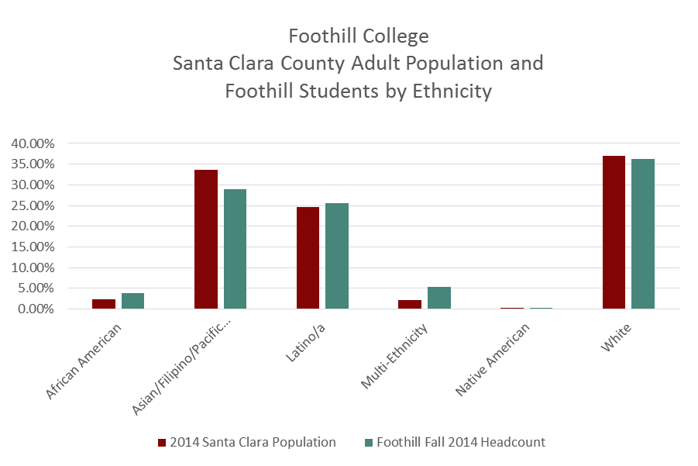
Access

Slide 3
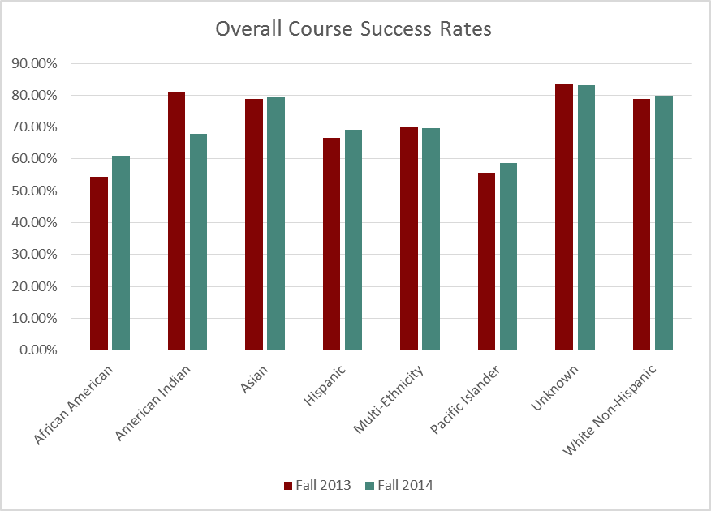
Overall Course Success Rates

Slide 4
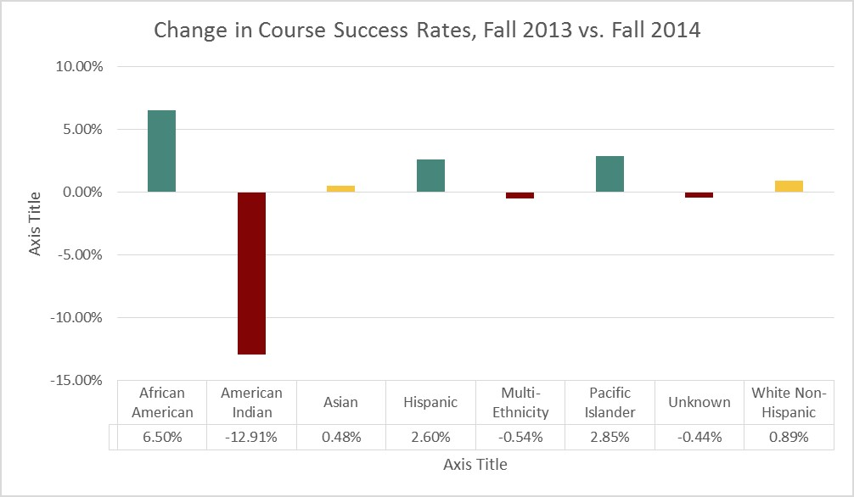
Course Success Rates and Equity Measures
Green vs. Yellow-Implications for Course Success and Equity

Slide 5
Course Completion/Course Success
Overall Facts as of Fall 2014
College-Level Course Success Rate: 76%
College-Level Course Success Rate for Fall 2013: 75%
Internet Based: 70% vs. Face-to-Face: 79%
No disproportionate impact by gender or age
African American and Pacific Island: around 60%, indicating disproportionate impact.
Hispanic Students: 69%, slightly below the reference group, but no longer a disproportionate impact
No disproportionate impact by DSPS status or Veteran status
Foster youth students: 59%, indicating a disproportionate impact

Slide 6
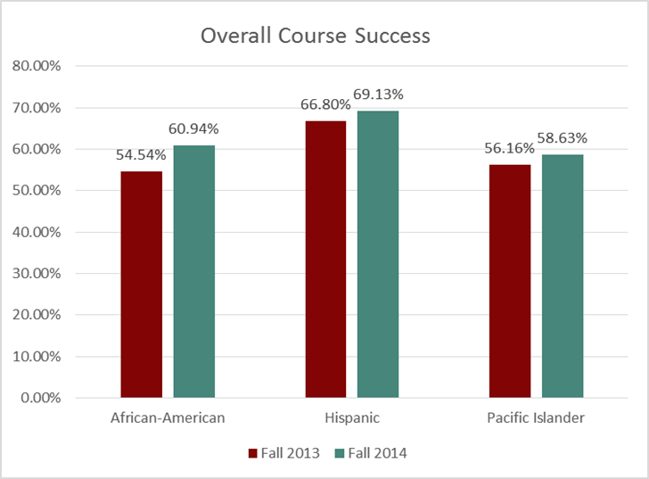
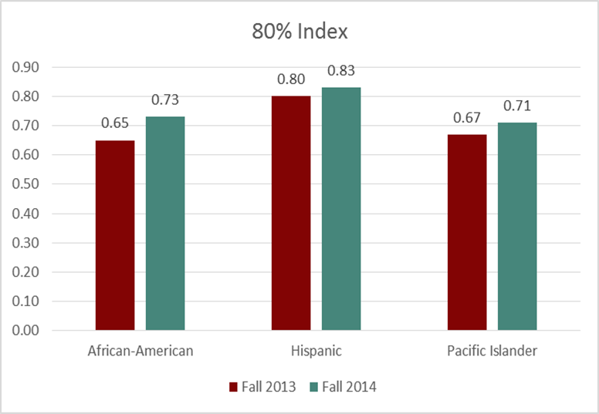
Changes from Last Year’s Report

Slide 7
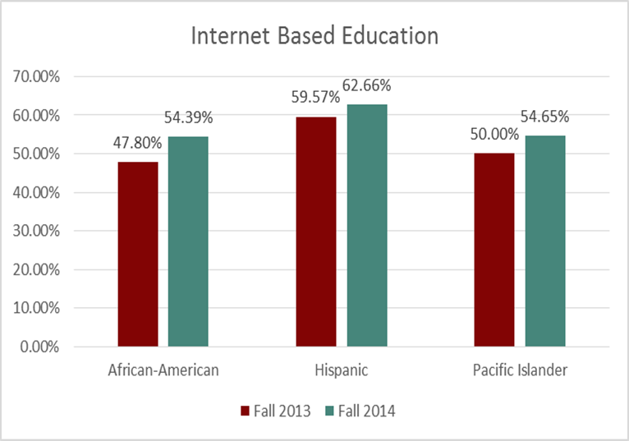
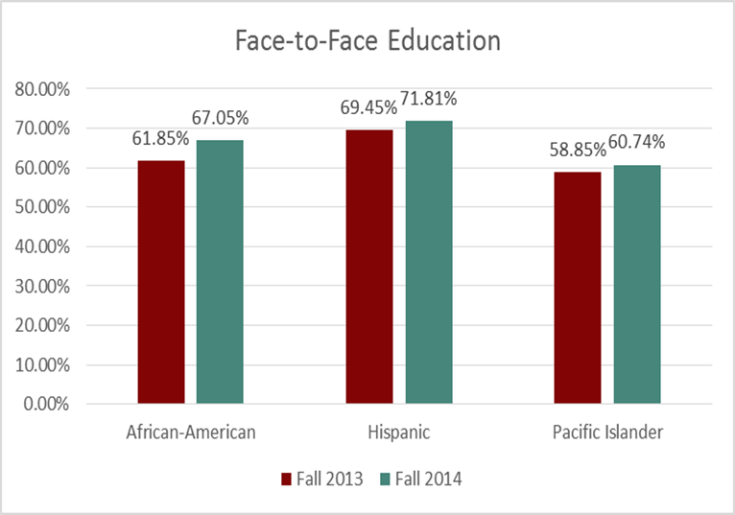
Internet Based and Face-to-Face Course Success Rates

Slide 8
Disciplines that targeted students experience a disproportionate impact in
Internet Based vs. Face-to-Face
Disproportionate impact by program/discipline
Due to different sizes of enrollment count, a convention is needed to determine whether a particular discipline is considered significant in terms of enrollment
Proposed convention: 3% of total enrollment by method of instruction

Slide 9
Disciplines that targeted students experience a disproportionate impact in
 | Internet Based | Face-to-Face
African American (Internet Based: 19, Face-to-Face:21) | Accounting, Biology, Kinesiology, Music | Biology, English, Mathematics
Hispanic (Internet Based: 68, Face-to-Face: 165) | Accounting, Anthropology, Child Development, English, History, Kinesiology, Music, Psychology, Sociology, Speech Communication | Biology, Chemistry, English, Mathematics, Psychology
Pacific Islander (Internet Based: 3, Face-to-Face: 5) | English, History, Kinesiology, Music, Psychology, Speech Communication | Anthropology, Chemistry, English, History, Mathematics

Slide 10
Course Success and Completion of English or Math
Both English and Math are identified as courses that the targeted groups experience a disproportionate impact in.
This signals a problem
Almost all other classes build upon the foundational skills in English and Math classes
A need to increase success rates for credit level English and Math classes for the targeted groups

Slide 11
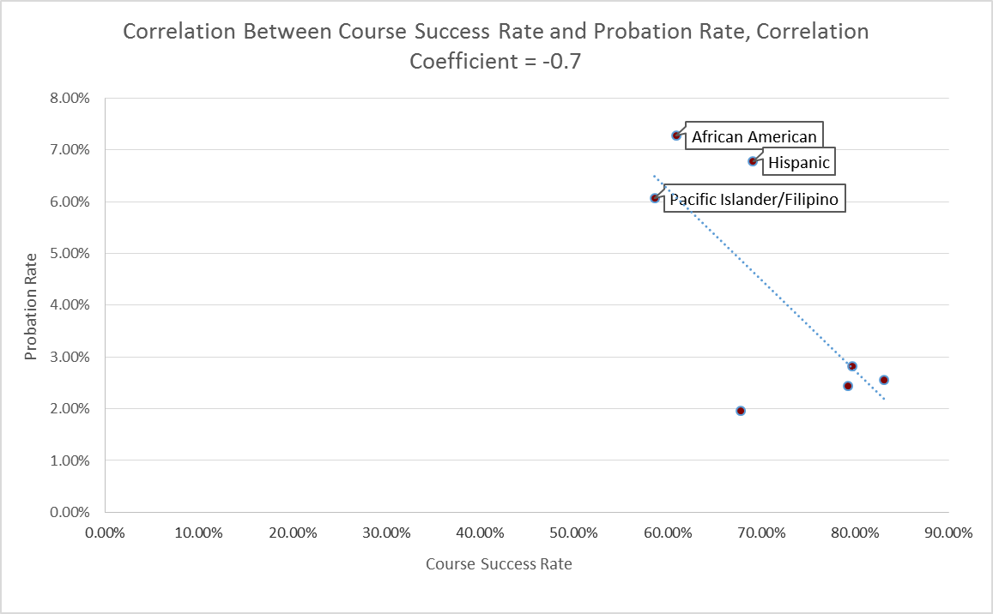
Course Success and Probation

Slide 12
Goals and Actions
Increase success rates for online classes, embedded tutoring
Individual survey/interview with students to identify what students need in order to succeed
Literature review on successful teaching and learning practices
Focus on disciplines/courses that the targeted students experience a disproportionate impact in
Focus on Math/English for targeted groups

Slide 13
Thank you.

