Slide 1



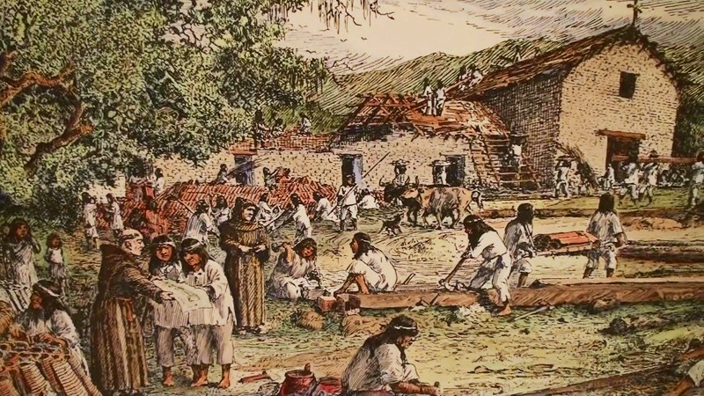
Land Acknowledgement
Who was here before us?
This Photo by Unknown Author is licensed under CC BY-SA

Slide 2
Sample Meeting Norms (from E&E)
Ask questions for clarification to help avoid making assumptions.
Make sure everyone’s voice is heard.
Step up and step back.
Listen actively without interrupting.
Clarify when you are advocating vs offering an idea.
Say it now, in the room. Avoid waiting till later to raise an issue.
All voices count. All opinions are valid, and offer reasoning behind your thinking.
Be honest – speak your truth as you see it. Use “I” phrases, and avoid assuming to speak on behalf of others.
It’s OK to reflect and change your mind.
Zoom: Avoid side conversations in the chat or by text...stay in the main conversation
Zoom: Raise your hand in the Participants box or make a note in the Chat Box when you have a question.

