Slide 1
Buildings, Grounds and Sustainability Bret Watson VP Finance & Administrative Services
November 3, 2023

Slide 2
Buildings, Grounds, and Sustainability Committee
Architectural Integrity of Campus
Signage and Lighting
Grounds issues
Sustainability
GHG Reduction
Energy Usage
Water Conservation
Recology – Waste Reduction

Slide 3
Members:
Asha Jossis
Audrey Capristo
Peter Chow (Danmin Deng)
Bob Cormia
Julie Ceballos
Simon Pennington
Samuel Connell
Joel Cortez
Gian Amrik (Student)
Mike Teijeiro
Bret Watson

Slide 4
Lighting Project
Measure G
Project 112 - Upgrade Campus Wide Lighting for Safety and Energy Efficiency
Budget $2,753,300

Slide 5
Path Lighting at Foothill College (The Past)

Slide 6
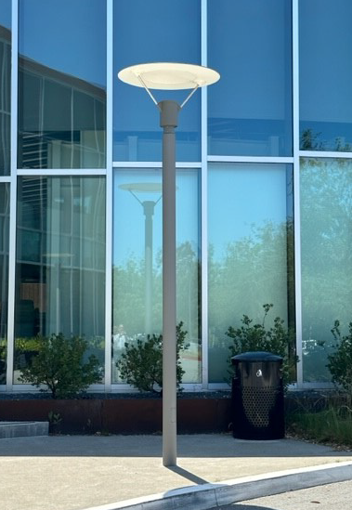
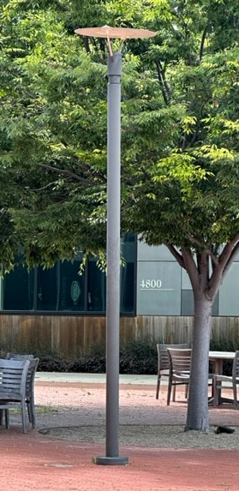
Various Light Fixtures Currently on the Foothill Main Campus

Slide 7
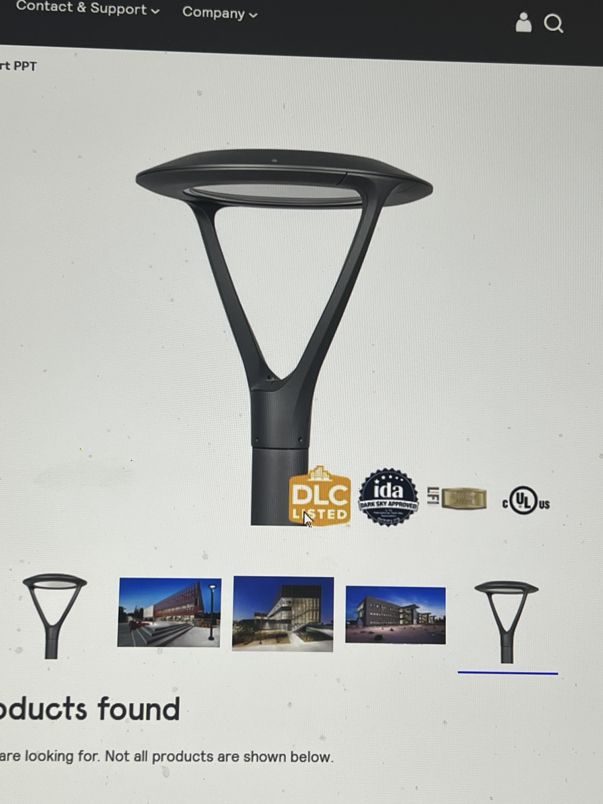
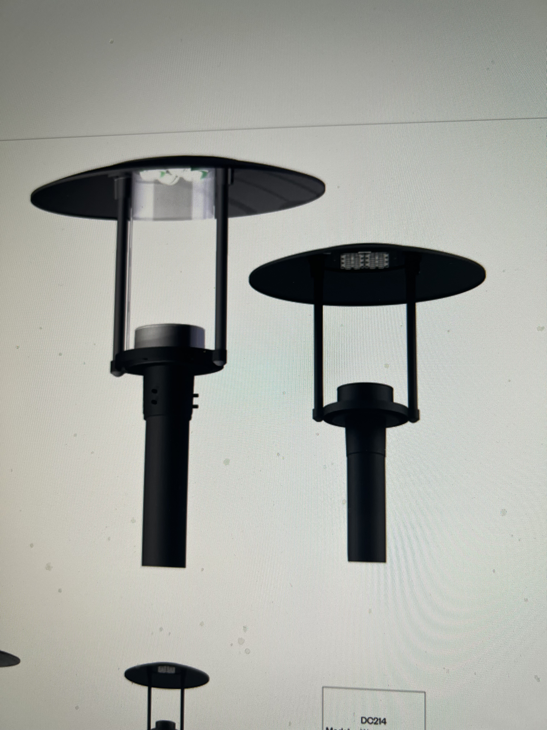
Possible Options for Future Lighting at Foothill

Slide 8
Next Steps
Install Sample lights
Review at Buildings,Grounds, & Sustainability
How well do they meet the lighting and safety requirements?
Cost of the options.
Money left to address lighting deficiencies and work toward sustainability goals.

Slide 9
Signage, Campus Site Access, and Wayfinding
Measure G
Project 111 – Upgrade Campus Site Access, Signage and Wayfinding
Budget = $15,831,400

Slide 10
Campus Signage

Slide 11
Campus Signage Next Steps
Committee to investigate changes in signage
Lighting and Signage sub-committee
Other participants across the campus
Review existing signage
Select a vendor to assist
Provide feedback on progress

Slide 12
Sustainability Action Plan
Look at Issues to address this year and beyond
Recology 3 Bin Pilot
Lighting to LED
Water conservation
Work with students (ASFC) on common goals
Integrate Strategic Equity Plan, Mission, Ed and Facilities Plans

Slide 13
Questions?

