Slide 1
Program Review PowerPoint Template
Integrated Planning & Budget Taskforce

Slide 2
Programs Strengths
Foothill Music Tech Graduates:
Demonstrate proficiency with digital media content creation, including hardware, software, and digital asset management.
Understand concepts from audio engineering, acoustics, sound synthesis, music theory, computer literacy and team collaboration.
Demonstrate proficiency with audio-video equipment including live content acquisition, microphones, cameras, sound reinforcement, post-production, and system troubleshooting.
Evaluate merits of professional media productions with an understanding of technical and aesthetic considerations.
Distinguish between related career paths associated with the discipline of Music Technology including digital media content creation, technical support, marketing, entrepreneurship and business administrative positions.

Slide 3
Program Actions for Improvement Identified
In contrast with the college’s 52% female enrollment, MTEC has averaged 19% female enrollment since 2014. Music technology is a male-dominated industry. Nationwide, higher-education statistics confirm very few women enter music technology programs.
MTEC is aware of this gender-related disparity and deploys ongoing marketing efforts to reach female students. This includes collaborating with Women’s Audio Mission, which provides training, work experience, career counseling, and job placement to over 2,000 women/girls annually in music technology.
In addition, MTEC faculty and staff strive to highlight examples of female students in the audio, video, and photo assets that are deployed across our social media accounts.
The MTEC program regularly features female industry professionals as guest presenters in our courses and Master Classes.

Slide 4
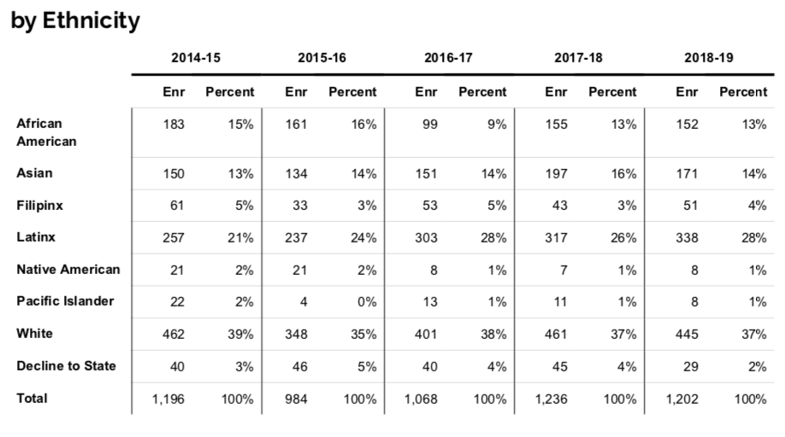
Program Data

Slide 5
Resources Needed
Marketing Resources:
Online Marketing Funnel
Pay-Per-Click Advertising
Video Production
Photography
Web Design
Social Media Marketing Assistant
Guest Speakers
Outreach
Equipment Resources:
Audio and Video Equipment
Musical Instruments
Equipment Maintenance

Slide 6
Questions

