Slide 1
Open Meetings: Brown Act

Slide 2
Intent of the Brown Act
“The people of this State do not yield their sovereignty to the agencies which serve them. The people, in delegating authority, do not give their public servants the right to decide what is good for the people to know and what is not good for them to know. The people insist on remaining informed so that they may retain control over the instruments they have created.”
- Government Code Section 54950

Slide 3

WHO?

Slide 4
Legislative Body (Gov Code §54952)
Local body created by state or federal statute
Committee (decision-making or advisory) created through formal action of a legislative body
Standing committees with a continuing subject matter jurisdiction or a fixed meeting schedule by formal action
Notes:
Robert

Slide 5
What about Academic Senate?
Title 5, section 53202 establishes the procedures for the formation of an academic senate.
The steps include a vote of the faculty, plus certain actions by the district board after the faculty vote (recognition of the senate, authorization for faculty to establish structures and procedures, etc.).
“The legally mandated joint action to be taken by the faculty of a community college and a district board in establishing an academic senate constitutes the requisite “formal action” contemplated by [the Brown Act].”
            - Attorney General Opinion No. 83-304 (1983)

Slide 6
Appointed Bodies - The Waterfall Effect
Subcommittees: What about subcommittees created by the District Academic Senate (if any), Student Senates, or College Academic Senates?
Bottom Line: Committees created by formal action of a legislative body are subject to the Brown Act.

Slide 7
Appointed Bodies – Standing Committees
Standing Committees of a legislative body are ALWAYS subject to the Brown Act.
    Standing committees, irrespective of composition, which have either: (1) a continuing subject matter jurisdiction, or (2) a meeting schedule fixed by resolution or formal action of the legislative body.
Examples: long-term committees on budgets, transportation, professional development, or curriculum.

Slide 8

HOW?

Slide 9
Relationship Between Parliamentary Procedure and the Brown Act
Brown Act is law
Parliamentary procedures are guidelines
Examples of overlap:
  Consider items on agenda only
  Recording of votes
  Public comments
    May impose time constraints
    Chair (and other members) do not respond
  Types of voting: for example, roll call vote when teleconferencing
Notes:
Erik

Slide 10

WHAT?

Slide 11
MEETINGS
“All meetings of the legislative body of a local agency shall be open and public, and all persons shall be permitted to attend any meeting of the legislative body of a local agency, except as otherwise provided in this chapter.” -GC Section 54953(a)

Slide 12
What is a “Meeting?”
“Any congregation of a majority of the members of a legislative body at the same time and location to hear, discuss, deliberate, or take action upon any item that is within the subject matter jurisdiction of the legislative body.”
- GC Section 54952.2(a)
The Brown Act is not limited to “meetings” where a final decision is made!
    “HEAR”
    “DISCUSS”
    “DELIBERATE”

Slide 13


Serial Meetings
“A majority of the members of a legislative body shall not…use a series of communications of any kind, directly or through intermediaries, to discuss, deliberate, or take action on any item of business that is within the subject matter jurisdiction of the legislative body.”
- GC Section 54952.2(b)(1)
Common Types of Serial Meetings:
  Daisy Chain
  Hub and Spoke
  Email

Slide 14
Brown Act Key Requirements
Agenda posted 72 hours in advance
Specify time and location of meeting
Posted in a location that is freely accessible to members of the public and on committee website (if there is one)
Provide opportunity for members of the public to attend and address the legislative body
Only deliberate on items on the agenda
Publicly report any action taken and vote of each member present
  No secret ballots for actions
Notes:
Erik

Slide 15

WHEN?

Slide 16
The Public’s Place at the Table (1)
The legislative body must provide an opportunity for members of the public to directly address the body on each agenda item before or during the legislative body’s discussion or consideration of the item.
Every agenda for a regular meeting must also allow members of the public to speak on any other item of interest within the subject matter jurisdiction of the legislative body (even if not on the agenda).

Slide 17
The Public’s Place at the Table (2)
The legislative body may not prohibit criticism of policies, procedures, programs or services of the legislative body/agency.
Reasonable regulations on public comment may be adopted (example: time limits for individual speakers).
The legislative body may remove individuals from a meeting who willfully interrupt proceedings.
-GC Section 54957.9

Slide 18
The Public’s Right to Attend
All meetings must comply with the ADA (Americans with Disabilities Act).
Any person may record the proceedings via audio recorder, video recorder or still motion camera.
No conditions may be set for attendance at or participation in a public meeting:
  Sign-in not required
  Self-identification not required as a prerequisite to speak
  No fees may be charged for providing notice

Slide 19

WHERE?

Slide 20
Zooming in?
Teleconferencing requires (§54953b):
  All votes by roll call
  Agendas posted at all teleconference locations
  Each teleconference location is identified in the agenda and notice of meeting
  Each teleconference location is accessible to the public
    Members of public may address the legislative body at each teleconference location
Notes:
Erik

Slide 21
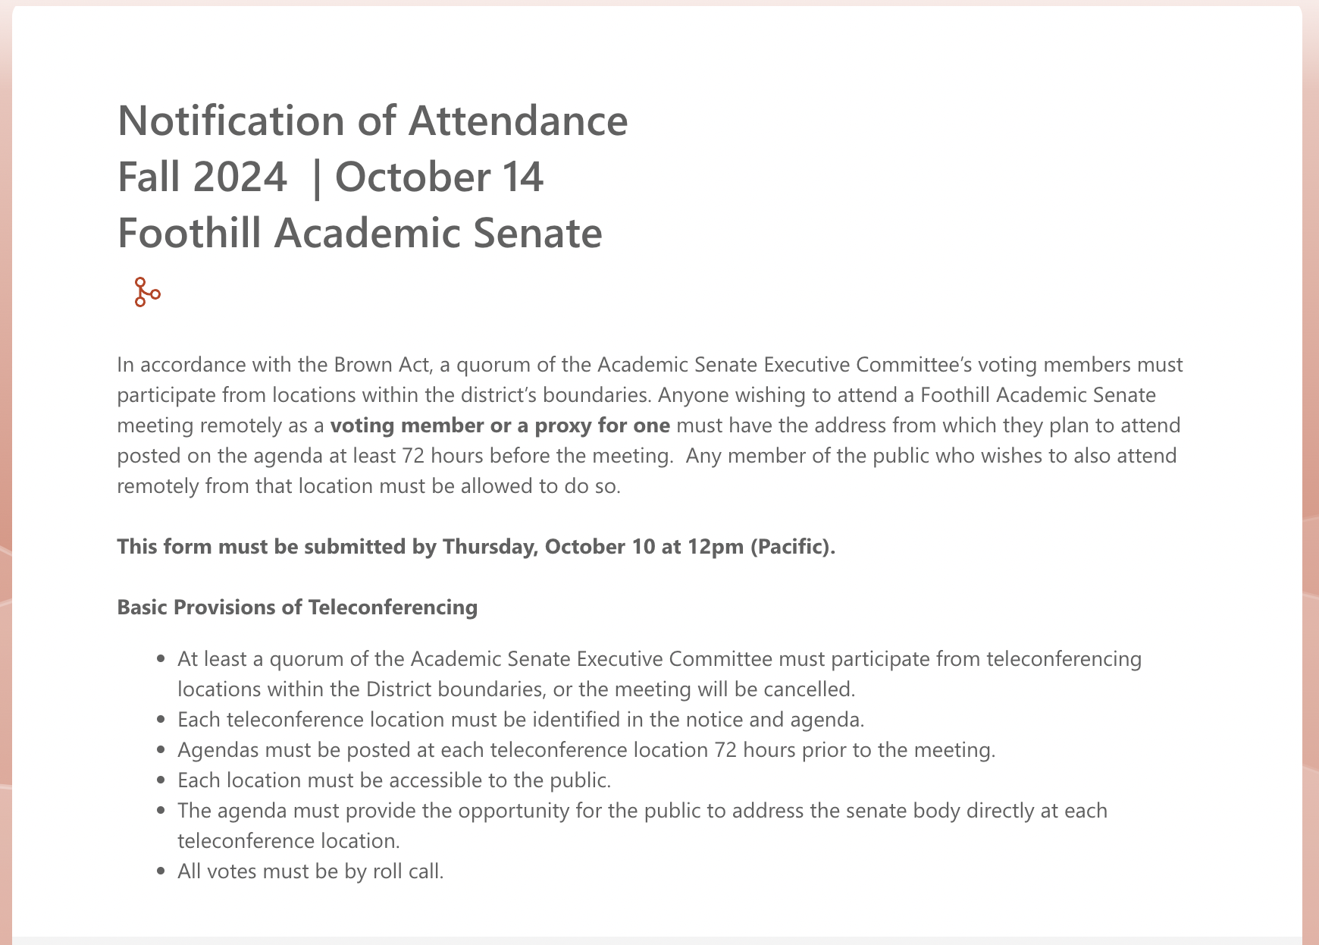
Notification of Attendance

Slide 22
Resources
Brown Act (full text)
Open and Public
Notes:
Robert

