Slide 1
Internal Environmental Scan
March 7, 2025

Slide 2
Foothill College Students

Slide 3
Historic Enrollment, by Ethnicity
Source: CCCCO DataMart

Slide 4
Snapshot: Ethnicity and Gender Fall 2024
Source: Foothill College Fall 2024 Census Report – does not include apprenticeships. N=11,586

Slide 5
Snapshot: Age and
Student Type, Fall 2024
Source: Foothill College Fall 2024 Census Report – does not include apprenticeships N=11,586

Slide 6
Enrollment Status, Compared
Source: CCCCO DataMart

Slide 7





International Students
442 enrolled in Fall 2024, comprising 3.8% of all students
Numbers have been trending upward since the drop during the pandemic, but have not yet returned to pre-pandemic levels
Top 5 Countries of Origin:
  China
  India
  South Korea
  Japan
  Brazil
Source: Foothill College Fall 2024 Census Report – does not include apprenticeships
Historic data from CCCCO DataMart

Slide 8
Distance Education, Compared
Source: CCCCO DataMart
Note: In Fall 2024, Foothill College Face-to-Face enrollment increased 6% and total Online/Hybrid increased 2% over Fall 2023
Source: Foothill College Fall 2024 Census Report – does not include apprenticeships

Slide 9
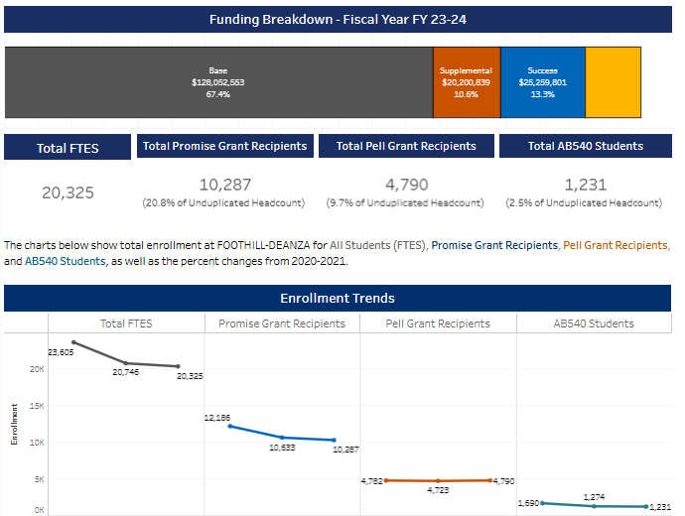
Foothill-De Anza CCD Dreamers, CPG, Pell Grant Recipients
The District has experienced decreases in CPG and AB540 students in recent years, which impacts funding
Percent of unduplicated District headcount in 2023-2024, compared to all CCCs:
  20.8% Promise
    36.7% for all CCCs
  9.7% Pell
    19.3% for all CCCs
  2.5% AB540
    2.3% for all CCCs
Source: CCCCO SCFF Dashboard

Slide 10
Headcount of CPG and Pell at Foothill
Source: CCCCO DataMart

Slide 11

Thoughts?

Slide 12
Student Outcomes
CCCCO DataVista

Slide 13
Students by Journey, Compared
2022-2023
Data include Non-Special Admit Students only (approx. 9% of Foothill students are Special Admit)
Foothill has a higher percent of Short-Term CTE and Undecided students than the region or the state
For Foothill, N= 8,874 Degree/Transfer, 5,871 Short-Term CTE, 3,025 Adult Ed/ESL, 7,097 Undecided
Silicon Valley includes De Anza, Evergreen, Foothill, Gavilan, Mission, San Jose City, and West Valley
Source: CCCCO DataVista

Slide 14
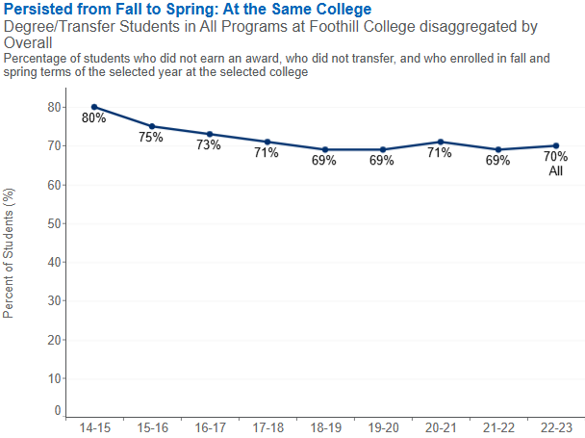
Degree/Transfer Students: Persistence
Source: CCCCO DataVista, most recent data from 2022-2023

Slide 15
Persistence, Disaggregated
Source: CCCCO DataVista, most recent data from 2022-2023
Note: Foothill Average = 70% (gold line)

Slide 16
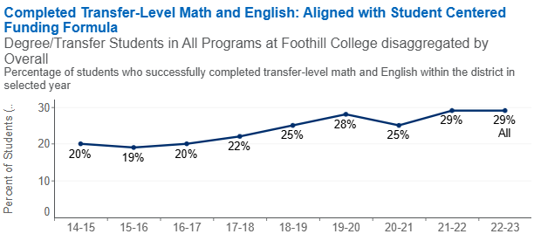
Degree/Transfer Students: Completed Transfer Level Math and English in Year 1
Source: CCCCO DataVista, most recent data from 2022-2023

Slide 17
Math + English in Year 1, Disaggregated
Source: CCCCO DataVista, most recent data from 2022-2023
Note: Foothill Average = 29% (gold line)

Slide 18
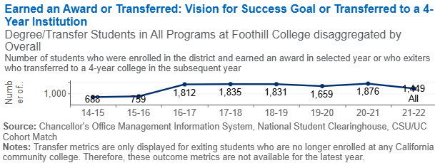
Degree/Transfer Students: Completion/Transfer
Corresponding percentages for the above chart, from 14-15 to 21-22:
14%, 12%, 13%, 14%, 15%, 14%, 16%, 16%
Source: CCCCO DataVista, most recent data from 2021-2022

Slide 19
Completion/Transfer, Disaggregated
Source: CCCCO DataVista, most recent data from 2021-2022
Note: Foothill Average = 16% (gold line)

Slide 20
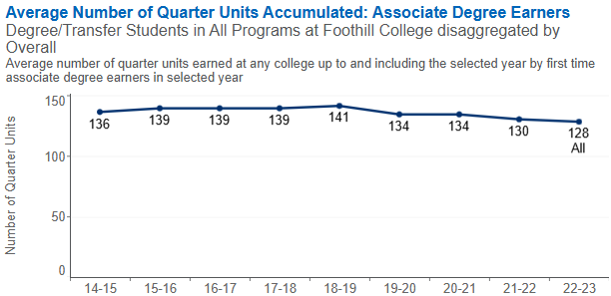
Degree/Transfer Students:
Units Upon Graduation
Source: CCCCO DataVista, most recent data from 2022-2023

Slide 21
Units Upon Graduation, Disaggregated
Source: CCCCO DataVista, most recent data from 2022-2023
Note: Foothill Average = 128 (gold line)

Slide 22
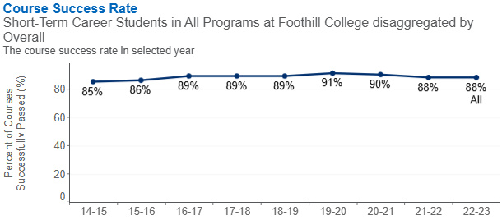
Short-Term CTE Students:
Course Success Rate
Source: CCCCO DataVista, most recent data from 2021-2022

Slide 23
CTE Course Success, Disaggregated
Source: CCCCO DataVista, most recent data from 2022-2023
Note: Foothill Average = 88% (gold line)

Slide 24
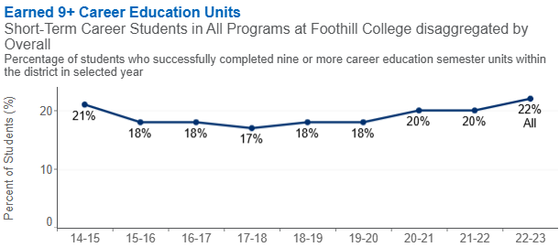
Short-Term CTE Students:
Earned 9+ Units
Source: CCCCO DataVista, most recent data from 2022-2023

Slide 25
9+ CTE Units, Disaggregated
Source: CCCCO DataVista, most recent data from 2022-2023
Note: Foothill Average = 22% (gold line)

Slide 26
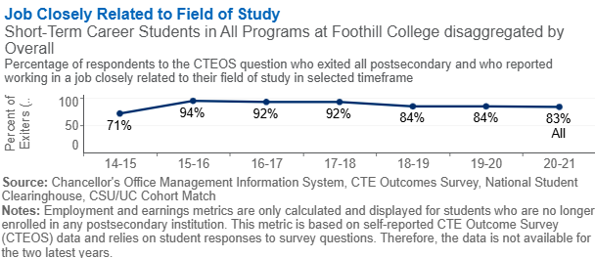
Short-Term CTE Students: Job Closely Related to Field of Study
Source: CCCCO DataVista, most recent data from 2020-2021

Slide 27
Job Closely Related to Field of Study, Disaggregated
Source: CCCCO DataVista, most recent data from 2020-2021
Note: Foothill Average = 83% (gold line)

Slide 28
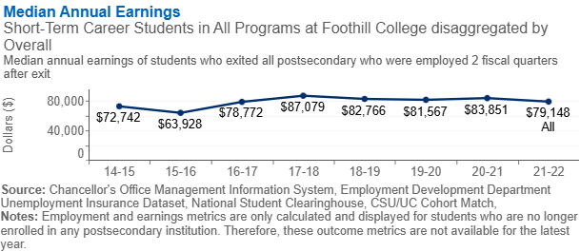
Short-Term CTE Students: Earnings
Source: CCCCO DataVista, most recent data from 2021-2022

Slide 29
Earnings, Disaggregated
Source: CCCCO DataVista, most recent data from 2021-2022
Note: Foothill Average = $79,148 (gold line)

Slide 30
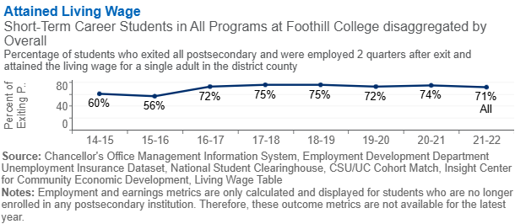
Short-Term CTE:
Attained Living Wage
Source: CCCCO DataVista, most recent data from 2021-2022

Slide 31
Attained Living Wage, Disaggregated
Source: CCCCO DataVista, most recent data from 2021-2022
Note: Foothill Average = 71% (gold line)

Slide 32
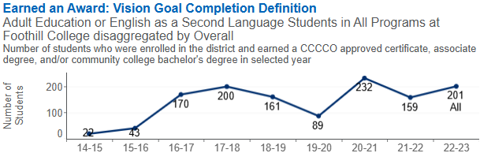
Adult Ed/ESL: Completion
Corresponding percentages for the above chart, from 14-15 to 22-23:
4%, 6%, 9%, 9%, 6%, 5%, 8%, 7%, 7%
Source: CCCCO DataVista, most recent data from 2022-2023

Slide 33
Completion, Disaggregated
Source: CCCCO DataVista, most recent data from 2022-2023
Note: Foothill Average = 7% (gold line)

Slide 34
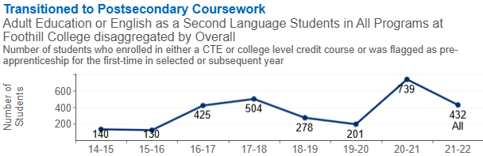
Adult Ed/ESL: Transitioned to Postsecondary Coursework
Source: CCCCO DataVista, most recent data from 2021-2022
Corresponding percentages for the above chart, from 14-15 to 21-22:
27%, 24%, 24%, 24%, 20%, 23%, 31%, 24%

Slide 35
Transition, Disaggregated
Source: CCCCO DataVista, most recent data from 2021-2022
Note: Foothill Average = 24% (gold line)

Slide 36
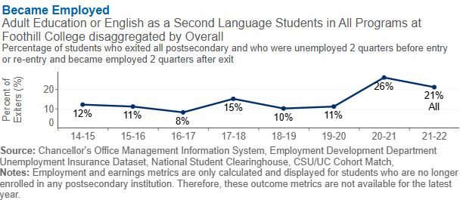
Adult Ed/ESL: Became Employed
Source: CCCCO DataVista, most recent data from 2021-2022

Slide 37
Became Employed, Disaggregated
Source: CCCCO DataVista, most recent data from 2022-2023
Note: Foothill Average = 21% (gold line)

Slide 38
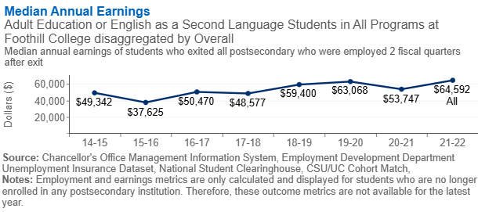
Adult Ed/ESL: Earnings
Source: CCCCO DataVista, most recent data from 2021-2022

Slide 39
Earnings, Disaggregated
Source: CCCCO DataVista, most recent data from 2022-2023
Note: Foothill Average = $64,592 (gold line)

Slide 40
Thoughts?

Slide 41
Student Outcomes
Awards, Transfer
CTE Employment Outcomes

Slide 42
Awards Conferred
Source: Internal Precision Degrees & Certificates Report

Slide 43
Top AA/AA-T Degrees Awarded
2023-2024
Associate in Arts
Associate in Arts for Transfer
Major | 2023-24
1GSS - General Studies: Social Science | 45
1ACC - Accounting | 15
1COS - Communication Studies | 15
1GID - Graphic & Interactive Design | 15
1MU1 - Music Technology | 13
1PSY - Psychology | 13
1JAP - Japanese | 12
1CHD - Child Development | 10
1SOC - Sociology | 9
1ART - Art | 8
Major | 2023-24
1PYT - Psychology for Transfer | 78
1CMT - Comm Studies for Transfer | 30
1SOT - Sociology for Transfer | 27
1KIT - Kinesiology for Transfer | 25
1ECT - Economics for Transfer | 23
1CDV - Chld & Adolescent Dev-Transfer | 19
1PST - Political Science for Transfer | 12
1ANT - Anthropology for Transfer | 8
1HIT - History for Transfer | 6
1ATT - Art History for Transfer | 5
Source: Internal Precision Degrees & Certificates Report

Slide 44
Top AS/AS-T Degrees Awarded
2023-2024
Associate in Science
Associate in Science for Transfer
Major | 2023-24
1V T - Veterinary Techn | 23
1RET - Respiratory Therapy | 22
1R T - Radiologic Technology | 22
1PAR - Paramedic | 18
1PT - Pharmacy Technician | 12
1DIM - Diagnostic Medical Sonography | 11
1D A - Dental Assisting | 8
1EGN - Engineering | 8
1GI4 - Geographic Inform Syst Tech | 8
1GSC - General Studies: Science | 8
Major | 2023-24
1BA2 - Business Admin for Transfer 2 | 51
1PHS - Public Health Sci for Transfer | 38
1BAT - Business Admin for Transfer | 21
1MTT - Mathematics for Transfer | 18
1BIT - Biology for Transfer | 10
1FTV - Film,TV & Elec Media-Transfer | 8
1PCT - Physics for Transfer | 4
1EAT - Early Chld Educ for Transfer | 2
1ENV - Environmental Sci for Transfer | 2
Source: Internal Precision Degrees & Certificates Report

Slide 45
Top Credit Certificates Awarded
Major | 2023-24
1RDD - Research Design Dev Global Good | 235
1EIW - Inside Wireman | 175
1IGC - Full IGETC Certification: CSU | 86
1EC1 - Early Child Educ Fundamentals | 57
1NDT - Non-Destructive Testing Tech | 46
1IDC - Full GE Breadth Certification | 35
1SC1 - Appr:Sound & Comm Installer | 35
1ICU - Full IGETC Certification: UC | 32
1ETS - Education Tech Specialist | 25
1MKR - Makerspace Coordinator | 24
1CM1 - Communication Studies I | 21
1SP4 - Appr:Steamfitng&Pipefiting Tec | 21
1SIL - STEAM Instructional Leadership | 20
1AC1 - Appr:Air Conditng & Refrig Tec | 16
1PT2 - Appr:Plumbing Technology | 16
Source: Internal Precision Degrees & Certificates Report

Slide 46
Top Bachelor Degree Awarded
Major | 2023-24
1DH - Dental Hygiene | 59
Source: Internal Precision Degrees & Certificates Report

Slide 47
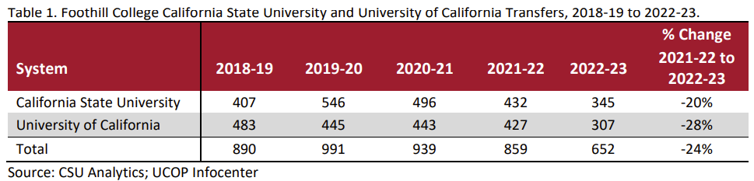
Transfer to UC, CSU

Slide 48
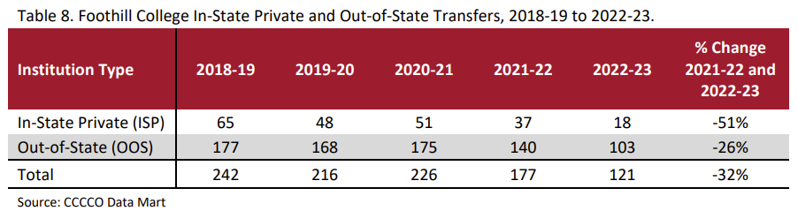

Transfer to ISP, OOS
Top In-State Private Transfer Destinations:
Santa Clara University
University of San Francisco
Top Out-of-State Transfer Destinations:
Arizona State University
Western Governor’s University
Southern New Hampshire University
Source: Internal Foothill Transfer Report

Slide 49

Foothill Transfers to CSU
Top Majors for Foothill Transfers to CSU Fall 2024
Psychology
Kinesiology/Physical Education
Business Administration
Computer Science
Communications
Source: CSU Data Dashboards and Internal Foothill Transfer Report

Slide 50



Foothill Transfers to UC
Top Majors for Foothill Transfers to UC, 2021-22 thru 2023-24
SOCIAL SCIENCES
MATHEMATICS AND STATISTICS
PSYCHOLOGY
BIOLOGICAL AND BIOMEDICAL SCIENCES
COMPUTER AND INFORMATION SCIENCES & SUPPORT SVCS
MULTI/INTERDISCIPLINARY STUDIES
BUSINESS, MANAGEMENT, MARKETING, & RELATED SUPPORT SVCS
ENGINEERING
VISUAL AND PERFORMING ARTS
COMMUNICATION, JOURNALISM, AND RELATED PROGRAMS
Source: UCOP InfoCenter and internal Foothill Transfer Report

Slide 51
UC and CSU Acceptance Rates
University of California, Fall 2023
California State University, Fall 2024
 | Foothill College | All CCC Transfers
Acceptance Rate | 82.3% | 76.8%
Yield Rate (enrolled) | 73.0% | 71.0%
 | Foothill College | All CCC Transfers
Acceptance Rate | 90.9% | 90.7%
Yield Rate (enrolled) | 52.6% | 64.8%
Top CCC Transfer Schools to SJSU, Fall 2024
De Anza Community College, Cupertino | 626
Evergreen Valley College, San Jose | 300
West Valley College, Saratoga | 180
Ohlone College, Fremont | 191
San Jose City College, San Jose | 148
Mission College, Santa Clara | 127
Foothill College, Los Altos Hills | 111
Cabrillo College, Aptos | 96
Diablo Valley College, Pleasant Hill | 98
Gavilan College, Gilroy | 68
Source: UCOP InfoCenter and CSU Data Dashboards

Slide 52

Career Education Outcomes Compared, 2023
 | Foothill College | All CCCs
N | 2,523 | 38,733
Response Rate | 20% | 23%
% Employed for Pay | 85% | 81%
Job Closely Related to Studies/Training | 83.3% | 71.3%
Program Satisfaction | 94.6% | 90.4%
Wages Prior to Studies/Training | $23.00 | $18.00
Wages After Studies/Training | $44.00 | $29.50
Change in Wages | $21.00 | $11.50
% Change in Wages | 91% | 64%
Foothill College students, and CCC students statewide, show an increase in earnings after participating in career education programs.
The increase in wages brings Foothill College students, on average, above the living wage (which is $35.44 for Santa Clara County)
Source: California Community Colleges Career & Technical Education Employment Outcomes Survey (CTEOS)
Santa Clara County Living Wage for ($35.44) for one adult no children (Source: MIT)

Slide 53
Foothill College CTE Awards with Highest Wage Gains
2013-2023
CTE Awards (Major or Certificate) with Highest % Wage Gains, 2013-2023
Foothill College participates in the annual statewide CTE Employment Outcomes Survey. Aggregated survey results from 2013-2023 show the Foothill College awards with the highest wage gains, an important outcome for CTE students.
Inside Wireman
AIR CONDITIONING & REFRIGERATION TECHNOLOGY
Radiologic Technology
Geographic Information Systems Technology
Primary Care Associate
Makerspace Coordinator
Dental Hygiene
Diagnostic Medical Sonography
PLUMBING TECHNOLOGY
General Electrician
Respiratory Therapy
Paramedic
Music Technology
Dental Assisting
Environmental Horticulture & Design
Source: California Community Colleges Career & Technical Education Employment Outcomes Survey (CTEOS)

Slide 54
Thoughts?

Slide 55
Thoughts?

