Slide 1
External Environmental Scan
January 31, 2025

Slide 2
National, State, Regional Data and Trends

Slide 3

National Trends
Social
  Public perception of the value of higher education is declining
  Student demographics are changing
  Students are increasingly demanding access to learning anytime, anywhere
Excerpted from 2024 EDUCAUSE Horizon Report: Teaching and Learning Edition

Slide 4

National Trends
Technological
Concerns about cybersecurity and privacy are increasing
The use of learning analytics continues to rise
The digital divide persists
Excerpted from 2024 EDUCAUSE Horizon Report: Teaching and Learning Edition

Slide 5

National Trends
Economic
The demand for and focus on workforce skills is growing
Challenges for employee retention are growing
Student debt is increasingly impacting students’ enrollment decisions
Excerpted from 2024 EDUCAUSE Horizon Report: Teaching and Learning Edition

Slide 6

National Trends
Environmental
Higher ed institutions are increasing their commitment to sustainability
Concerns about the impact of big data tools on the environment are rising
The demand for green skills in the workforce is increasing
Excerpted from 2024 EDUCAUSE Horizon Report: Teaching and Learning Edition

Slide 7

National Trends
Political
Political polarization in the United States continues to impact higher education
Government policy is increasingly influencing education
The need is growing for policies that address emerging technologies
Excerpted from 2024 EDUCAUSE Horizon Report: Teaching and Learning Edition

Slide 8

National Trends
Artificial Intelligence
Social: AI is changing the way we communicate
Technological: AI tools have growing potential to reshape pedagogy and student experiences
Economic: AI is increasingly having an impact on the economy and workforce
Environmental: AI is increasingly being used to address climate change and sustainability issues
Political: The potential for the use of AI in politics is growing
Excerpted from 2024 EDUCAUSE Horizon Report: Teaching and Learning Edition

Slide 9

Thoughts?

Slide 10
External Initiatives

Slide 11

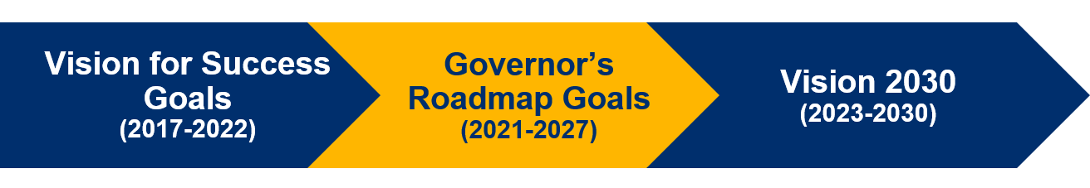
State Trends
California Community Colleges Initiatives
Vision for Success
  Guided Pathways
  Student Centered Funding Formula
Governor’s Roadmap for CCCs
Vision 2030

Slide 12
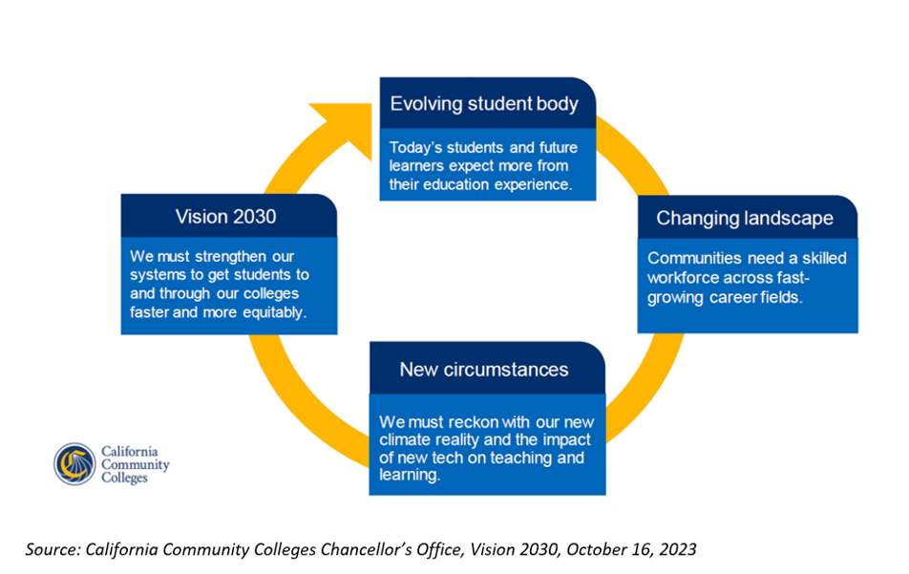
Vision 2030: Meeting the Needs of Today and the Opportunities of Tomorrow

Slide 13
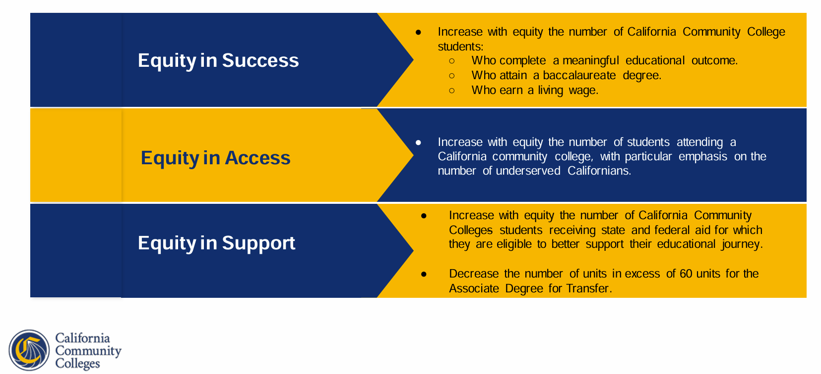
Vision 2030: Goals and Metrics

Slide 14
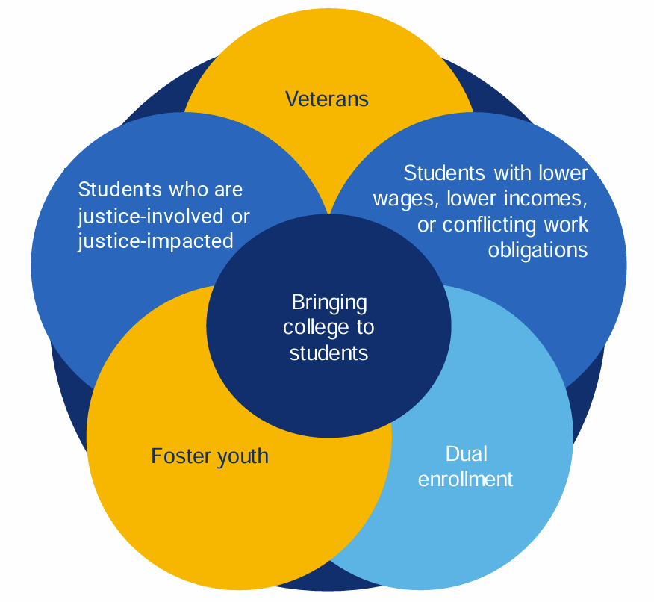
Vision 2030:
New Pathways to Reach Future Learners
Strategic Directions
Equitable Baccalaureate Attainment
Equitable Workforce & Economic Development
Generative Artificial Intelligence and the Future of Learning

Slide 15


California State Plan for Career & Technical Education, 2023
Initial Goals
Boost data-informed decision-making for equity & impact
Expand work-based learning in all regions with a focus on equity
Grow dual enrollment in all regions with a focus on equity
Understand and plan to address CTE teacher & faculty shortages

Slide 16
Student Centered Funding Formula
Factored into Base Allocation
Credit Inmates in Correctional Facilities
CDCP
Credit Special Admit Students
Student Success Allocation Metrics
Associate Degree for Transfer (ADT)
Associate Degree
Baccalaureate Degree
Credit Certificate
Transfer to a Four-Year University
Completion of Transfer Level Math and English in Year 1
Nine or More CTE Units
Attainment of Regional Living Wage
Supplemental Allocation Metrics
AB540 Students
Pell Grant Recipients
Promise Grant Recipients
Source: CCCCO

Slide 17

Strong Workforce Priority Sectors
High Priority Sectors
Advanced Manufacturing
Advanced Transportation and Logistics
Health
Information and Communication Technologies - Digital Media
Public Safety
Priority Sectors
Agriculture, Water, and Environmental Technologies
Business & Entrepreneurship
Education & Human Development
Energy Construction & Utilities
Global Trade
Life Sciences - Biotechnology
Retail, Hospitality, & Tourism
Source: BACCC Regional Plan 2022-2024

Slide 18
Thoughts?

Slide 19
Foothill College Service Area

Slide 20
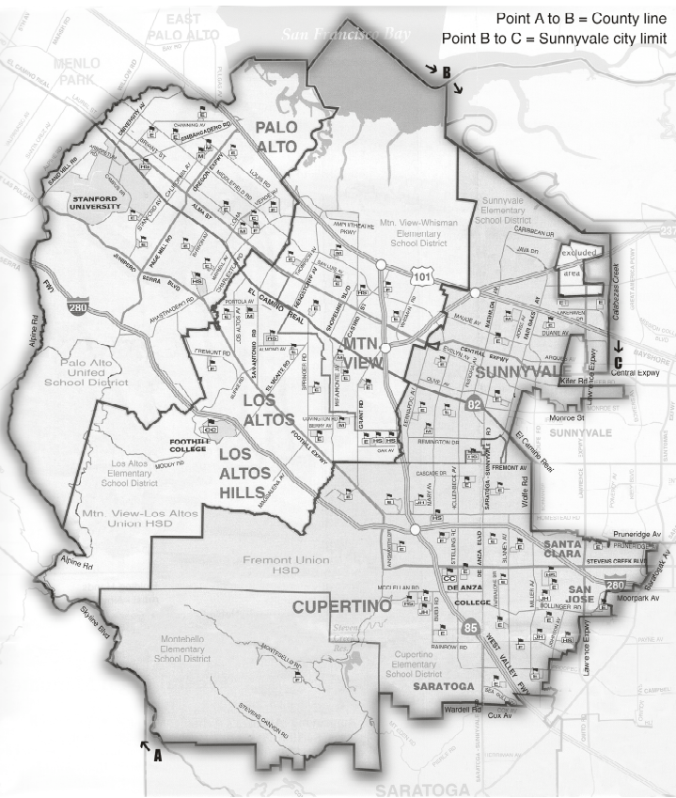
District and College Boundaries
While Foothill College serves students from a broad region, there are four cities within the college boundaries:
Los Altos
Los Altos Hills
Mountain View
Palo Alto

Slide 21
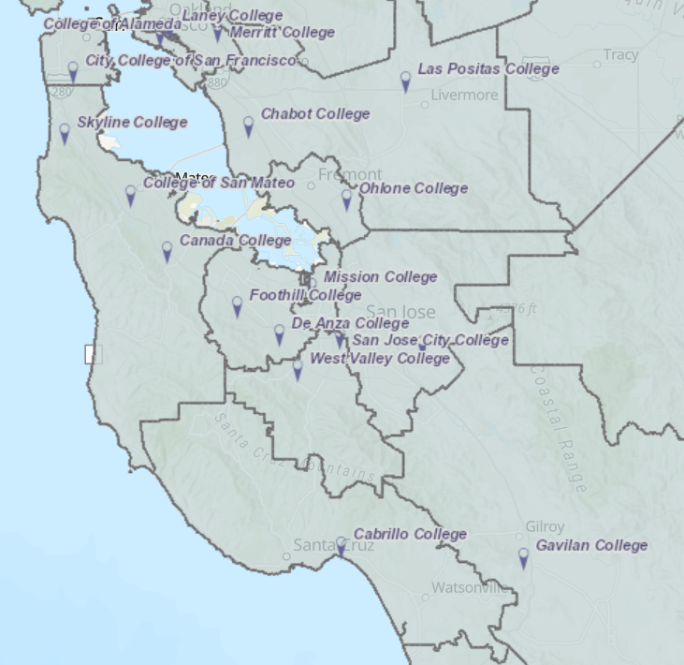
Foothill College Students by ZIP
County | # of Students
Santa Clara Co | 7,917
San Mateo Co | 1,575
Alameda Co | 679
Contra Costa Co | 116
San Francisco Co | 116
San Benito Co | 112
Santa Cruz Co | 69
San Luis Obispo Co | 52
Merced Co | 33
San Joaquin Co | 28
CITY | # of Students
SAN JOSE CA | 2,842
PALO ALTO CA | 1,378
MOUNTAIN VIEW CA | 1,029
SUNNYVALE CA | 725
LOS ALTOS CA | 518
REDWOOD CITY CA | 505
SANTA CLARA CA | 379
MENLO PARK CA | 312
FREMONT CA | 298
CUPERTINO CA | 284
MILPITAS CA | 227
SAN MATEO CA | 188
Calculated for all ZIP codes with 25+ enrollments in Fall 2023. Data Source: CCCCO. Map: Foundation CCC

Slide 22
If not Foothill College, Where?
CCCs with enrollments of 30 or more in Fall 2023 where student ZIP code is from Los Altos, Los Altos Hills, Mountain View or Palo Alto (in Foothill Boundaries):
College | Enrollment
Foothill | 2,968
De Anza | 735
Cañada | 378
College of San Mateo | 215
West Valley College | 148
Skyline | 102
San Jose City | 65
Santa Barbara City | 38
Evergreen Valley | 33
Of those who reside within Foothill’s boundaries and attend a community college, the vast majority choose Foothill. Other popular choices include:
De Anza
Cañada
San Mateo
West Valley

Slide 23
Population of Santa Clara and San Mateo Counties, Historic and Projected
Projected
The population of Santa Clara and San Mateo Counties grew rapidly in the past century, but is projected to decrease in the coming decades
Source: CA Department of Finance

Slide 24
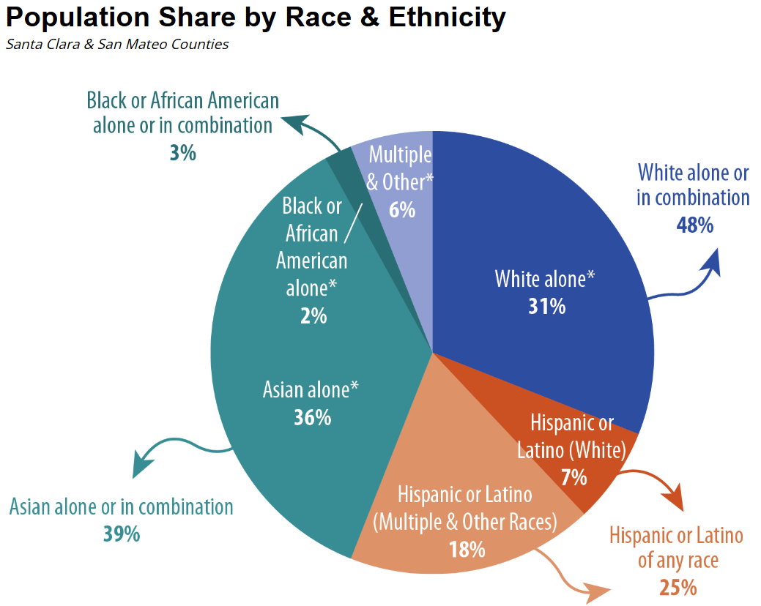
Population of Santa Clara and San Mateo Counties, by Ethnicity
There is no ethnic majority group in Santa Clara and San Mateo Counties
Source: Silicon Valley Indicators

Slide 25
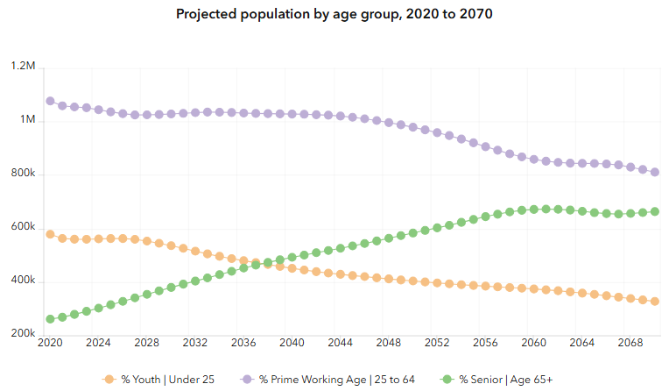
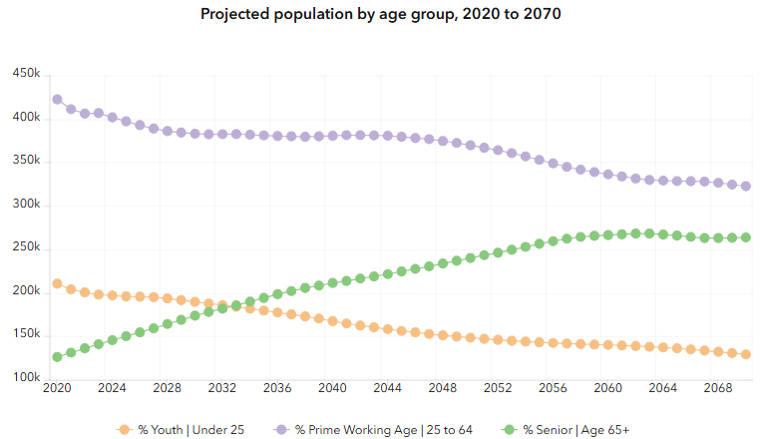
Projections by Age, 2020-2070
Santa Clara County
San Mateo County
At the same time the overall population is projected to decrease slightly, the proportion of youth and prime working aged adults is projected to decrease over the next decades, while the proportion of senior citizens is projected to increase
Source: CA Department of Finance, Population Projections

Slide 26
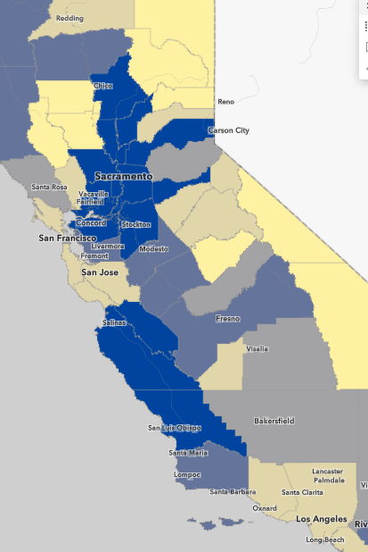
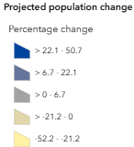

Projected Population Change, 2020-2070
Santa Clara, San Mateo, Santa Cruz, and San Francisco Counties are expected to shrink
Counties to the east and south are projected to grow
Source: CA Department of Finance, Population Projections 2024

Slide 27
Foothill Area Cities, Compared
Fact | Los Altos Hills | Los Altos | Palo Alto | Mountain View | Santa Clara Co
Population estimates 2023 | 8,189 | 29,990 | 65,882 | 81,785 | 1,877,592
Population, % change 2020-2023 | -3.8% | -4.7% | -3.9% | -0.9% | -3.0%
Asian | 39.3% | 37.5% | 36.1% | 34.5% | 41.9%
White | 49.3% | 50.5% | 47.3% | 39.3% | 27.6%
Latino | 5.0% | 5.5% | 7.1% | 18.0% | 25.0%
Foreign-born persons, percent, 2019-2023 | 35.7% | 34.6% | 36.3% | 42.8% | 41.0%
Language other than English spoken at home | 38.5% | 37.2% | 40.3% | 49.3% | 54.7%
Bachelor's degree or higher, % of persons age 25+ | 85.6% | 87.2% | 82.4% | 74.3% | 55.9%
Per capita income in past 12 months | $173,837 | $142,907 | $121,565 | $106,510 | $77,018
Persons in poverty, percent | 4.5% | 3.1% | 5.4% | 5.5% | 7.6%
Median gross rent, 2019-2023 | $3,500+ | $3,500+ | $3,328 | $2,975 | $2,814
The demographics of Los Altos Hills, Los Altos, Palo Alto and, to a lesser extent, Mountain View are remarkably similar
In comparison, the county as a whole shows relatively lower affluence, a higher proportion of Whites, and fewer Latinos
Source: US Census Quickfacts

Slide 28
Demographics of Service Area
Fact | San Mateo County | Santa Clara County | California | United States
Population estimates, 2023 | 726,353 | 1,877,592 | 38,965,193 | 334,914,895
Population, percent change - 2020-2023 | -5.00% | -3.00% | -1.40% | 1.00%
Black | 3% | 3% | 7% | 14%
American Indian and Alaska Native | 1% | 1% | 2% | 1%
Asian | 33% | 42% | 17% | 6%
Native Hawaiian/Pacific Islander | 1% | 1% | 1% | 0%
Two or More Races | 5% | 4% | 4% | 3%
Latino | 25% | 25% | 40% | 20%
White | 36% | 28% | 34% | 58%
Population in the service area is decreasing at a higher rate than the state or nation
San Mateo and Santa Clara Counties have a higher proportion of Asians than the state or nation
Source: US Census Quickfacts

Slide 29
Demographics of Service Area
Fact | San Mateo County | Santa Clara County | California | United States
Persons under 18 years | 19% | 20% | 22% | 22%
Foreign-born persons | 36% | 41% | 27% | 14%
Language other than English spoken at home | 45.3% | 54.7% | 44.1% | 22.0%
Bachelor's degree or higher | 53.1% | 55.9% | 36.5% | 35.0%
With a disability, under age 65 | 5.0% | 5.0% | 7.3% | 9.1%
Households with a computer | 97.5% | 97.8% | 96.4% | 94.8%
Households with broadband Internet | 95.2% | 95.1% | 92.5% | 89.7%
Santa Clara and San Mateo County have fewer youth and more foreign-born persons than the state or nation, and higher educational attainment levels
The state and nation have lower proportions of households with computers and broadband internet
Source: US Census Quickfacts

Slide 30
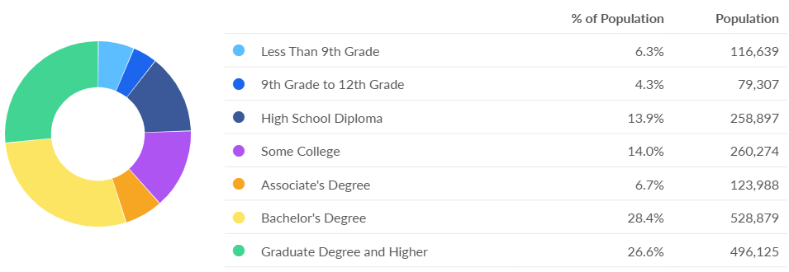
Educational Attainment, Aged 25+
38.5% of adults in Santa Clara and San Mateo Counties have less than an Associate Degree
Source: Lightcast
Region: Santa Clara and San Mateo Counties

Slide 31
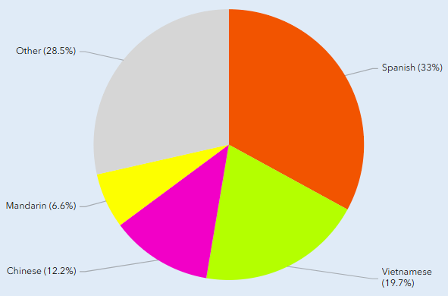
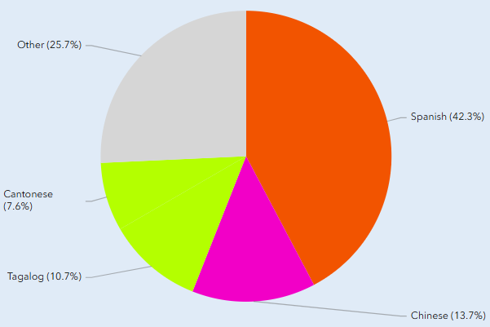
Language Other Than English Spoken at Home
Santa Clara County
San Mateo County
Source: CA Department of Finance, Language Microdata

Slide 32
Service Area Demographics, Compared
Fact | San Mateo County | Santa Clara County | California | United States
Median household income | $156,000 | $159,674 | $96,334 | $78,538
Per capita income in past 12 months | $81,980 | $77,018 | $47,977 | $43,289
Persons in poverty | 7.3% | 7.6% | 12.0% | 11.1%
Population per square mile, 2020 | 1,704 | 1,500 | 254 | 94
Median value of owner-occupied housing units | $1,494,500 | $1,382,800 | $695,400 | $303,400
Median gross rent | $2,893 | $2,814 | $1,956 | $1,348
Mean travel time to work (minutes) | 27.3 | 27 | 29 | 26.6
Santa Clara and San Mateo Counties are relatively more affluent than the state or the nation, with much higher population density
Source: US Census Quickfacts

Slide 33
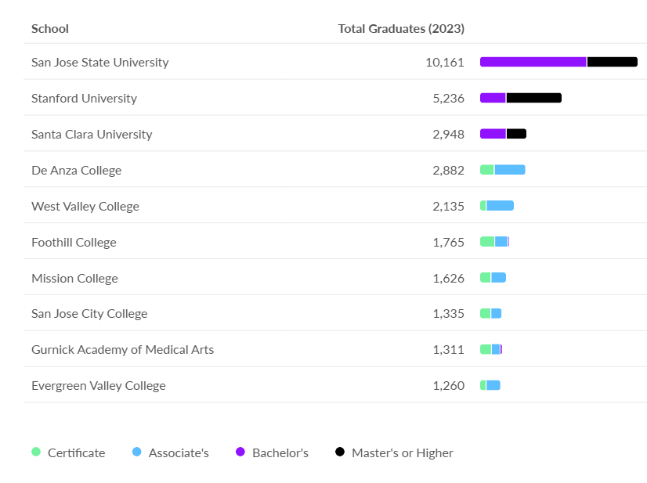
Top 10 Regional
Postsecondary Institutions
Source: Lightcast
Region: Santa Clara and San Mateo Counties

Slide 34
Thoughts?

Slide 35
Labor Market Information

Slide 36
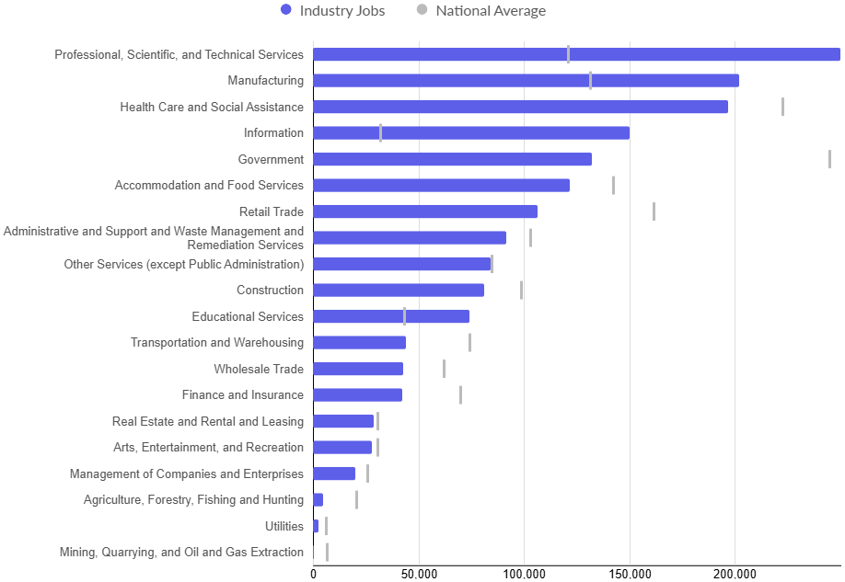
Top Industries, Santa Clara and San Mateo Counties, 2023
Source: Lightcast
Region: Santa Clara and San Mateo Counties

Slide 37
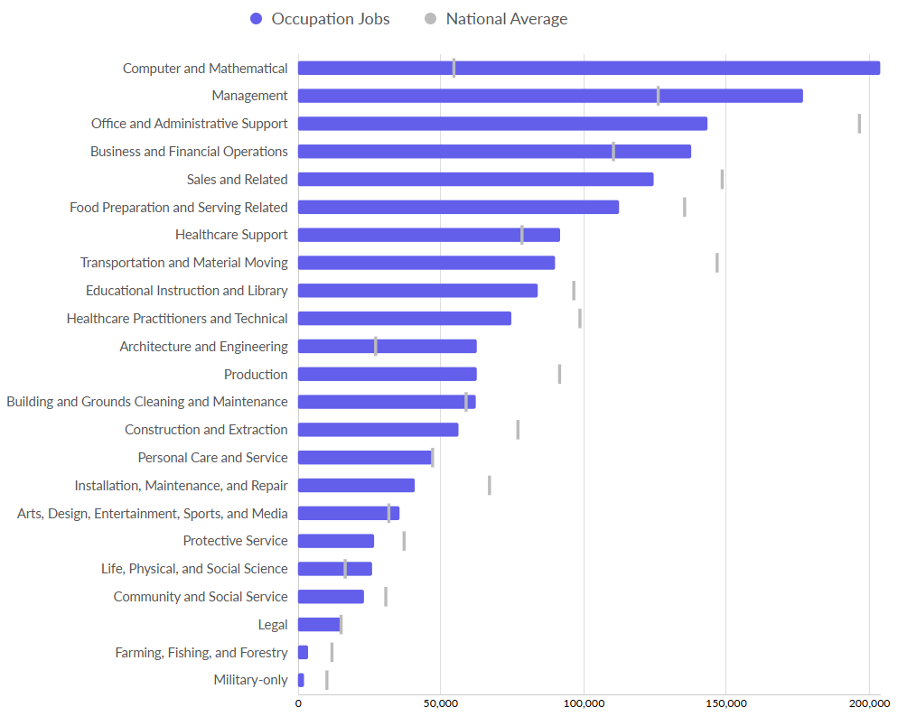
Top Occupations, Santa Clara and San Mateo Counties ,2023
Source: Lightcast
Region: Santa Clara and San Mateo Counties

Slide 38
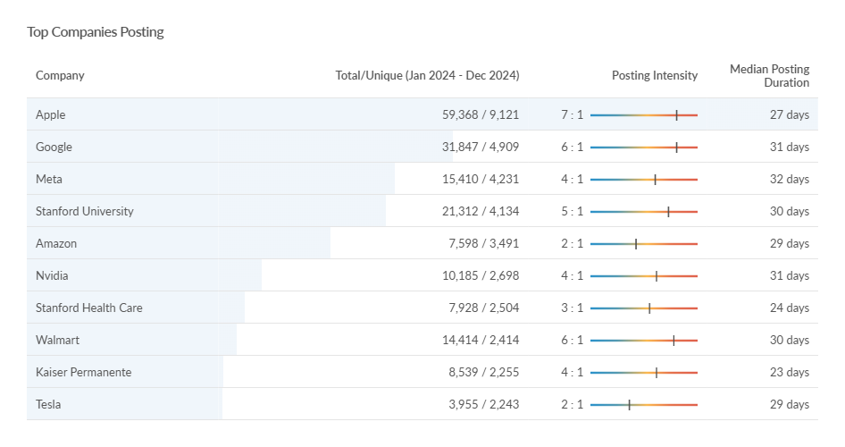
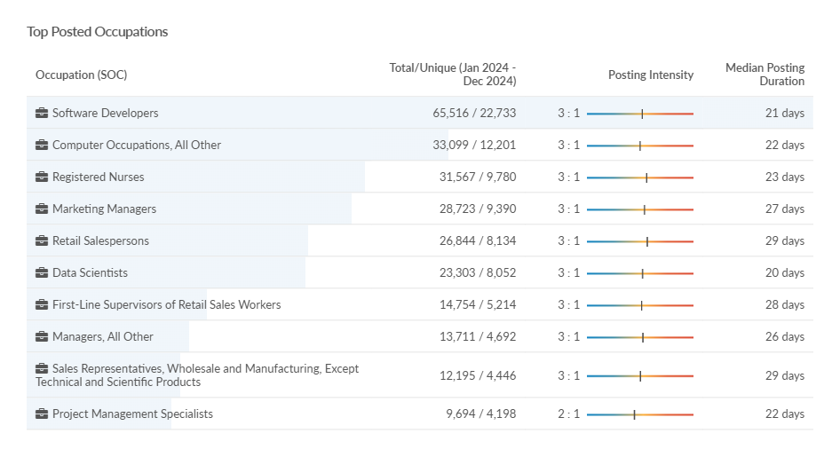
Job Postings Data, 2024
Top 10 Employers
Top 10 Occupations
Source: Lightcast Region: Santa Clara and San Mateo Counties
Data for all job postings that do not require Bachelor degree or higher

Slide 39
Top 10 Labor Market Gaps, Associate Degree Earners
Job Description | 2023 Jobs | 2022 - 2023 % Change | Avg. Annual Openings | Regional Completions (2023) | Gap | Foothill College Completions (2023) | Median Hourly Earnings
Computer Network Support Specialists | 1850 | -13.1% | 145 | 1836 | (1691) | 86 | $45.22
Human Resources Assistants | 975 | -14.1% | 126 | 1501 | (1375) | 90 | $30.40
Environmental Science and Protection Techs | 463 | -4.1% | 50 | 832 | (782) | 18 | $31.33
Life, Physical, and Social Science Techs | 1722 | 3.4% | 287 | 828 | (541) | 44 | $40.67
Desktop Publishers | 117 | -4.9% | 14 | 439 | (425) | 38 | $38.10
Industrial Engineering Techs | 817 | 16.3% | 178 | 558 | (380) | 3 | $37.43
Dietetic Technicians | 388 | 28.7% | 119 | 394 | (275) | 4 | $22.44
Aerospace Engineering and Operations Techs | 190 | 12.0% | 37 | 311 | (274) | 0 | $47.72
Geological Techs | 105 | -18.7% | 13 | 241 | (228) | 9 | $31.15
Hydrologic Technicians | 37 | 36.5% | 13 | 222 | (209) | 3 | $27.97
Source: Lightcast Region: Santa Clara and San Mateo Counties
Green indicates above the Living Wage for Santa Clara County ($32.99) Source: MIT

Slide 40
Top 10 Labor Market Gaps, Certificate Earners
Job Description | 2023 Jobs | 2022 - 2023 % Change | Avg. Annual Openings | Regional Completions (2023) | Gap | Foothill College Completions (2023) | Median Hourly Earnings
Library Technicians | 712 | -10.0% | 134 | 956 | (822) | 15 | $26.59
Health Techs | 1631 | -2.8% | 126 | 627 | (501) | 76 | $34.00
Licensed Practical and Licensed Vocational Nurses | 4789 | 1.9% | 469 | 919 | (450) | 0 | $41.15
Makeup Artists, Theatrical and Performance | 214 | 14.2% | 57 | 467 | (410) | 7 | $46.86
Fire Inspectors and Investigators | 46 | -22.1% | 5 | 323 | (318) | 0 | $50.95
Skincare Specialists | 1325 | 7.5% | 260 | 527 | (267) | 0 | $25.69
Sound Engineering Technicians | 366 | -3.2% | 47 | 299 | (252) | 34 | $42.79
Medical Records Specialists | 1302 | -8.8% | 97 | 346 | (249) | 36 | $35.80
Motorcycle Mechanics | 114 | -1.4% | 13 | 215 | (202) | 0 | $28.34
Electrical and Electronics Installers and Repairers, Transportation Equipment | 115 | -16.2% | 14 | 215 | (201) | 0 | $67.20
Source: Lightcast Region: Santa Clara and San Mateo Counties
Green indicates above the Living Wage for Santa Clara County ($32.99) Source: MIT

Slide 41
Top 10 Labor Market Gaps, Bachelor Degree Earners
Job Description | 2023 Jobs | 2022 - 2023 % Change | Avg. Annual Openings | Regional Completions (2023) | Gap | Median Hourly Earnings
Managers, All Other | 34772 | 3.0% | 3757 | 14572 | (10815) | $72.13
Human Resources Specialists | 11572 | 0.8% | 1038 | 9037 | (7999) | $49.65
Chief Executives | 8623 | 3.1% | 811 | 8805 | (7994) | $89.62
Financial Managers | 15689 | 0.6% | 1212 | 8498 | (7286) | $96.21
Sales Managers | 15236 | 3.0% | 1511 | 8771 | (7260) | $95.65
Project Management Specialists | 15749 | 4.7% | 1745 | 8760 | (7015) | $67.70
General and Operations Managers | 27828 | 0.3% | 2287 | 8829 | (6542) | $76.28
Marketing Managers | 12435 | 5.4% | 1562 | 8066 | (6504) | $101.48
Business Operations Specialists, All Other | 21688 | -1.0% | 2548 | 8972 | (6424) | $57.51
Human Resources Managers | 4065 | 2.0% | 374 | 5150 | (4776) | $101.20
Source: Lightcast Region=Santa Clara and San Mateo Counties
Green indicates above the Living Wage for Santa Clara County ($32.99) Source: MIT

Slide 42

Remote Work
One in five workers nationally is working remotely
16% of companies are fully remote, operating without a physical office
The highest percentage of remote workers are aged 24 to 35 – within this age group, 39% work remotely full-time and 25% do so part time
The top industries for remote work are Computer & IT, Accounting and Finance, Marketing, Medical & Health, Project Management, Customer Service, Sales, Administrative, HR & Recruiting, and Operations.
The top remote job titles are Accountant, Executive Assistant, Financial Analyst, Product Manager, Customer Service Rep, Software Engineer, Customer Success Manager, Accounting Manager, Product Designer, and Writer.
Source: US Census and other data quoted in Forbes

Slide 43
Thoughts?

Slide 44
K-12 Feeder Schools

Slide 45
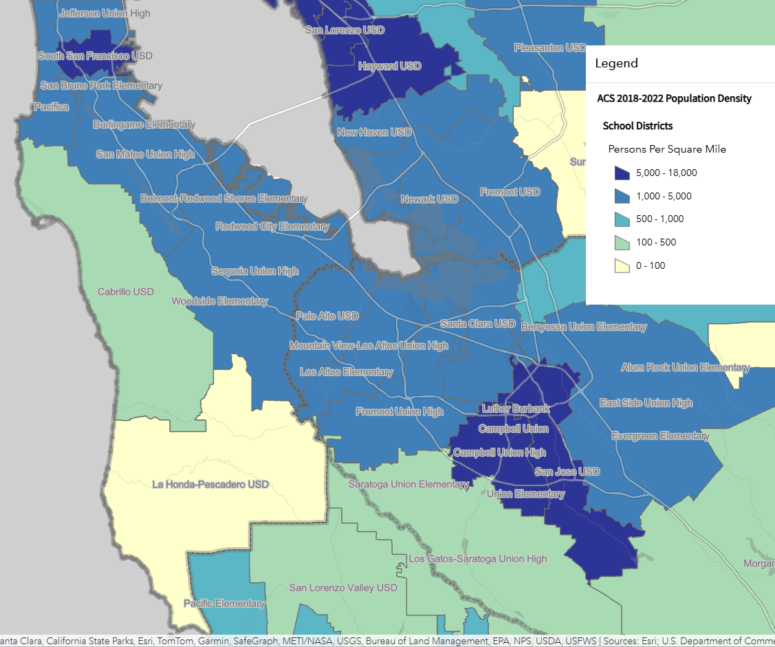
High Schools within Foothill College Boundary
Mountain View/Los Altos UHSD
Mountain View
Los Altos
Alta Vista
Palo Alto USD
Henry M. Gunn
Palo Alto
Source: CA Department of Finance: Population Density Map by School District

Slide 46
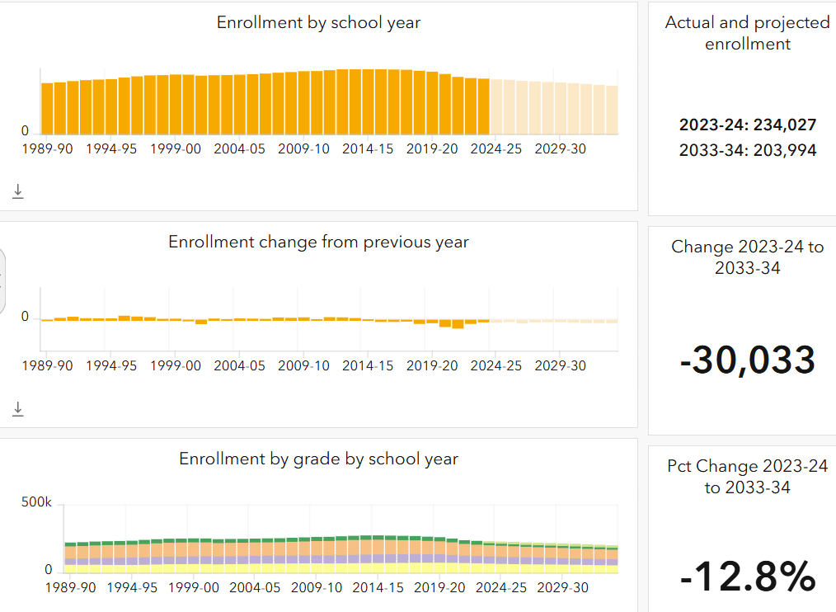
Projected Enrollment, Santa Clara County

Slide 47
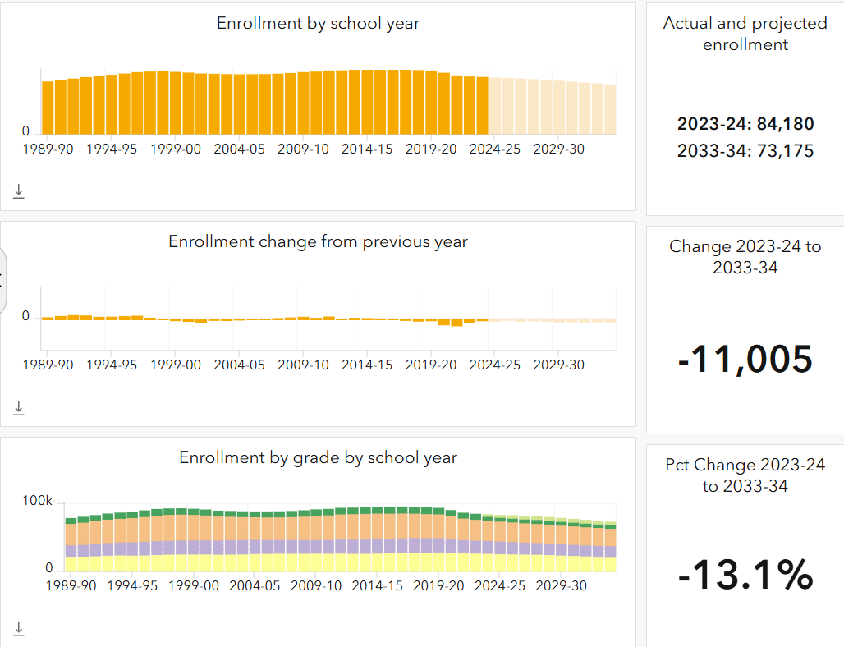
Projected Enrollment, San Mateo County

Slide 48
Service Area High Schools, Compared
2021-2022 | Twelfth Grade Cohort | Cohort Grad Rate | % Meeting UC/CSU Requirements | Overall College Going Rate | % of Grads going to college choosing a CCC
Alta Vista HS | 29 | 72.4% | 0% | 29.0% | 77.8%
Los Altos HS | 558 | 98.0% | 72.4% | 80.5% | 24.8%
Mountain View HS | 586 | 92.4% | 75.0% | 81.4% | 24.6%
Henry M. Gunn HS | 486 | 96.1% | 92.7% | 84.2% | 17.7%
Palo Alto HS | 552 | 97.1% | 93.3% | 86.6% | 14.6%
Santa Clara Co | 19,410 | 92.3% | 64.1% | 75.8% | 42.2%
San Mateo CO | 6,711 | 90.5% | 64.4% | 77.2% | 45.2%
California | 427,386 | 87.0% | 51.1% | 63.6% | 52.7%
Santa Clara and San Mateo have higher graduation and college going rates, and a higher % of students meeting UC/CSU requirements, than the state average – but – a lower proportion enrolling in a CCC.
These differences are even more pronounced for highs schools in Foothill’s boundary
Source: CDE DataQuest

Slide 49
Thoughts?

