Slide 1
Jeremy Adam Smith
October 7, 2016, Foothills College

Slide 2
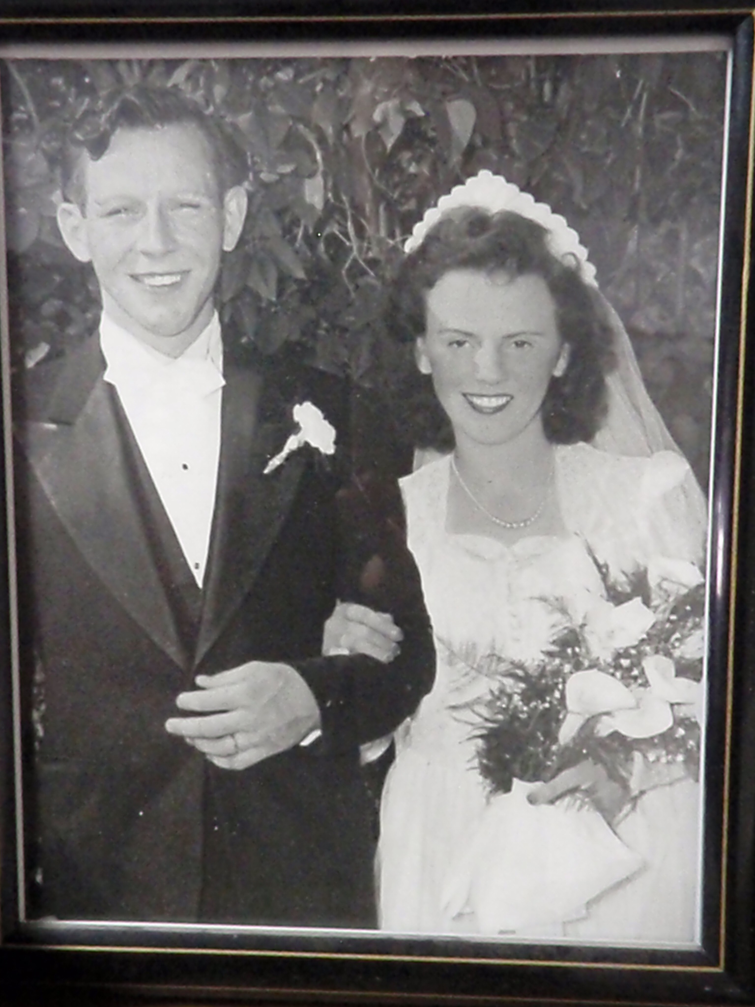

Slide 3
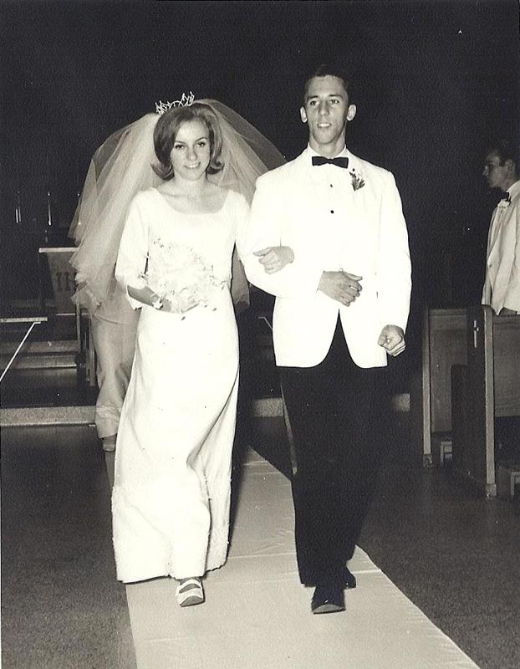

Slide 4
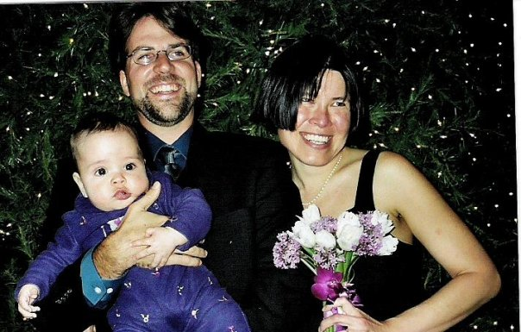

Slide 5
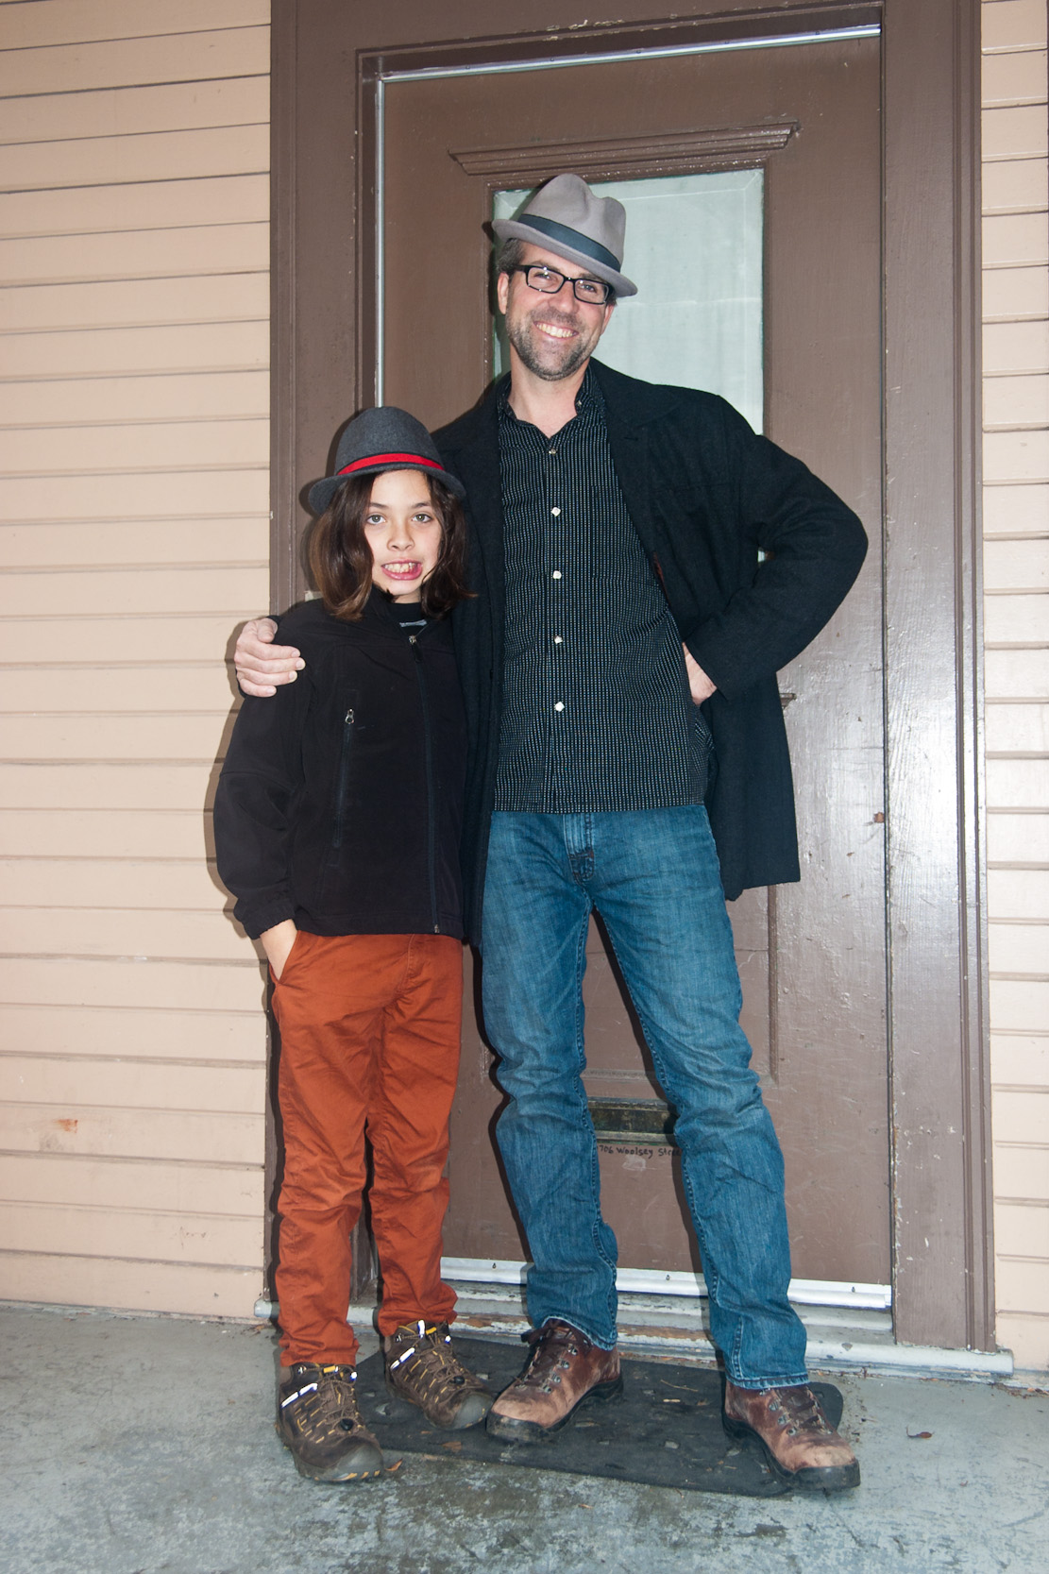

Slide 6
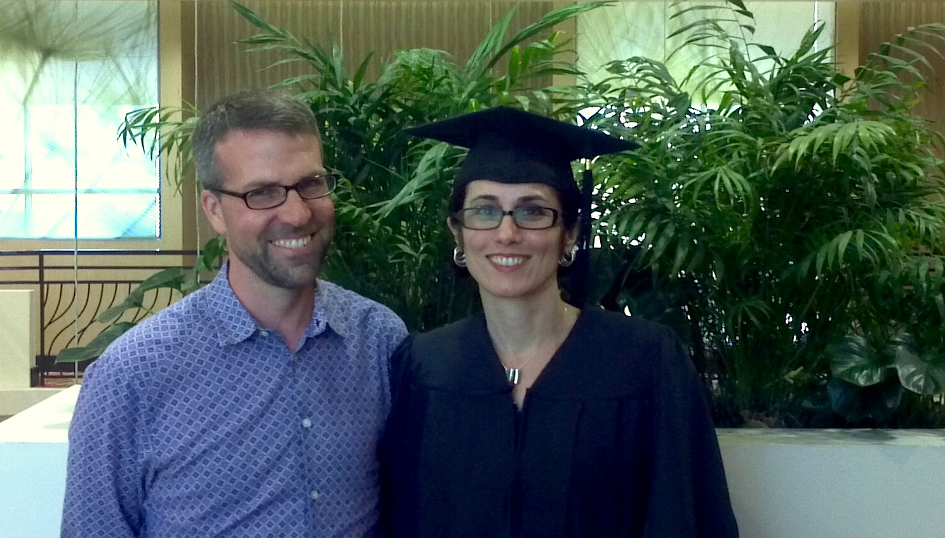

Slide 7


Slide 8
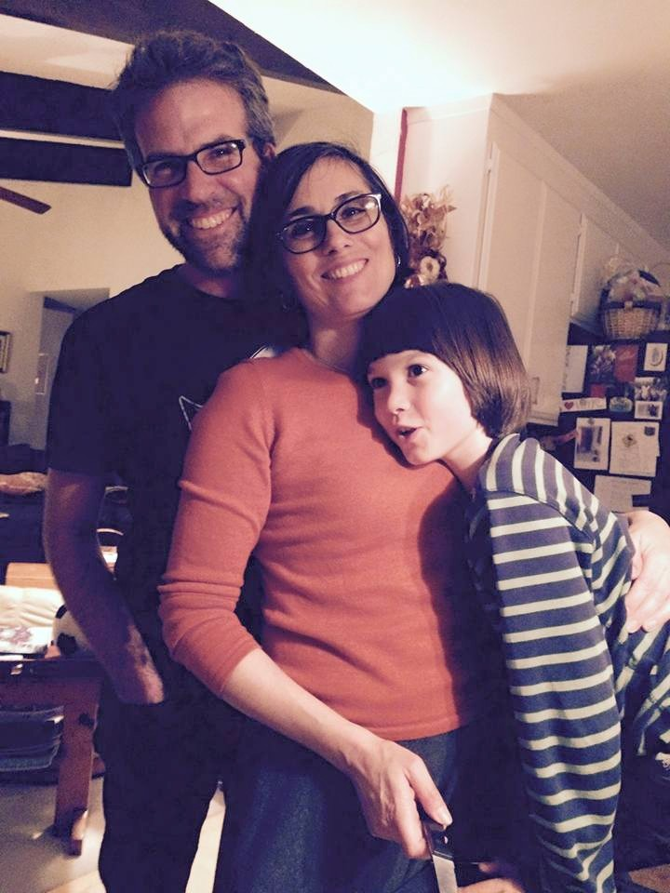

Slide 9
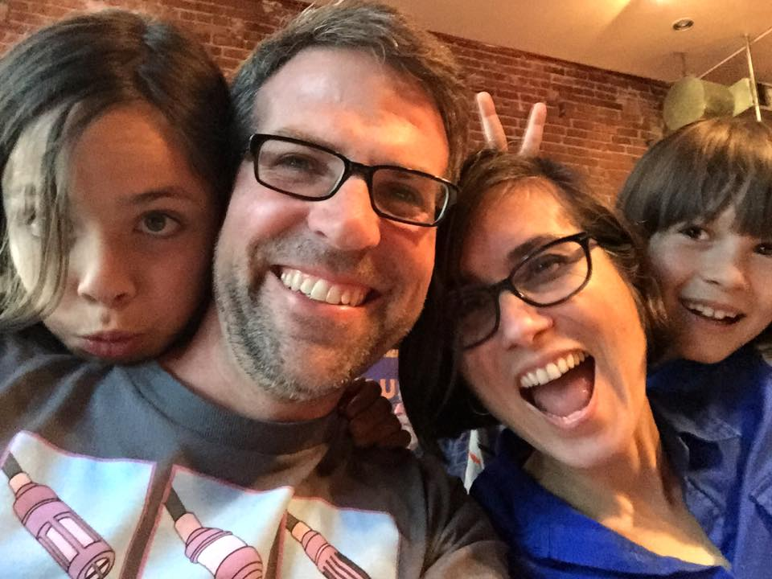

Slide 10
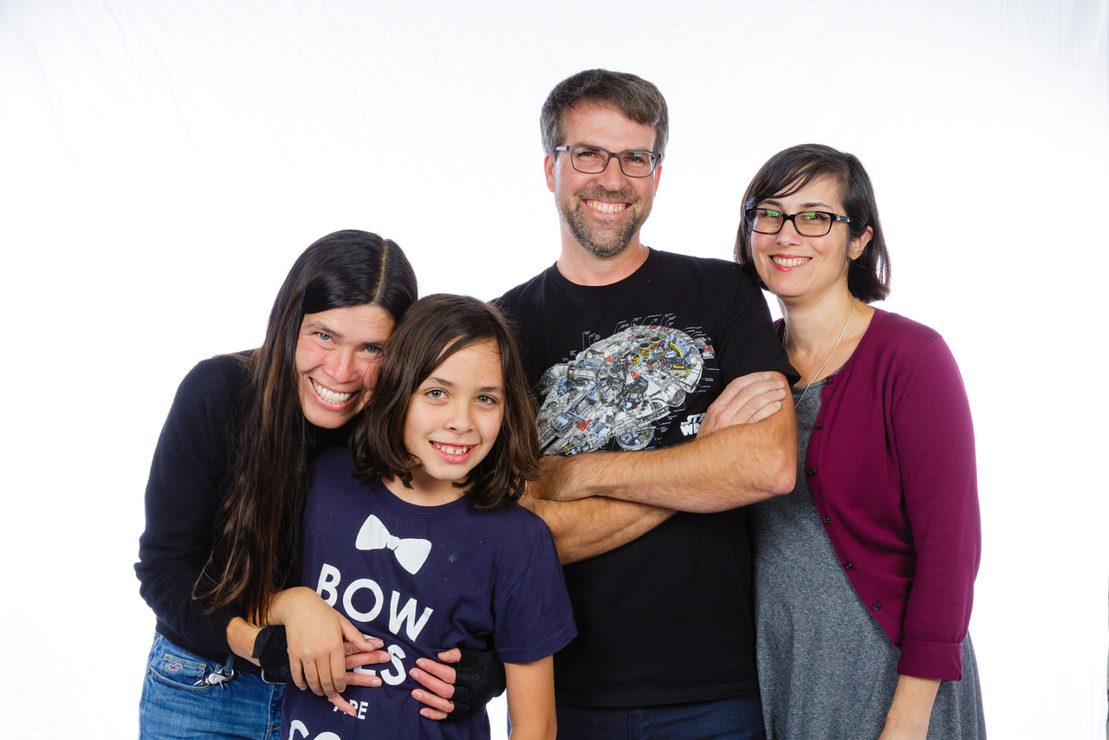

Slide 11
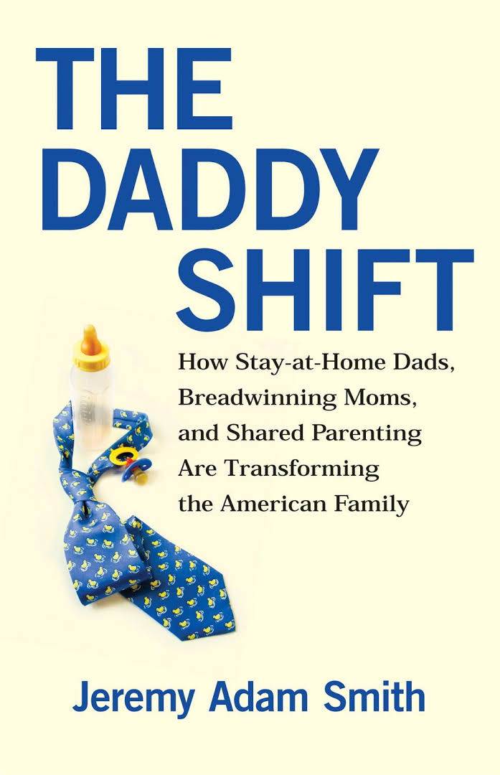
I call the rise in male caregiving
“the Daddy Shift”

Slide 12
Major Factors Driving the Daddy Shift
Men lost the ability to reliably support families on one income alone
Women went to school and work
People began to move away from families
These are stressful changes!

Slide 13

How can we be happy in the face of these changes?
I have six suggestions*
*Batteries not included. One size does not fit all. Offer valid only at participating sites.

Slide 14
1. Count what we’ve gained

Slide 15
2. Count the good things in your co-caregivers & co-workers

Slide 16
3. Say “Thank you” for those things*
*And say “thanks” to the people

Slide 17
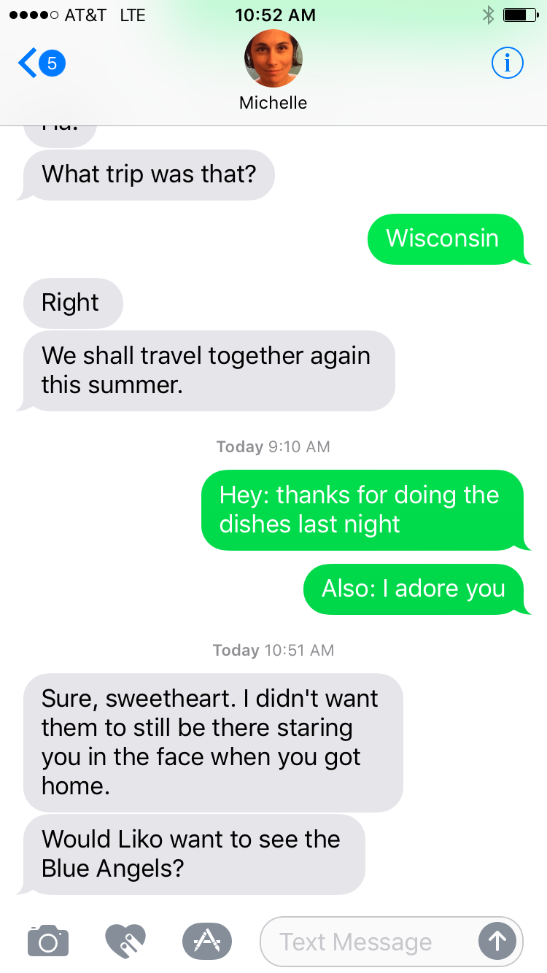

Slide 18
4. Be intentional, be present

Slide 19
5. Be kind to yourself

Slide 20
6. Know your story, tell your story to each other

Slide 21
Some Suggestions for Mobilizing Men for Work-Family Balance
Respect the ways men take care of children and homes
Fathers should take their own aspirations to equality and involvement seriously—and so should mothers & women in general
Even so, speak the language of meaning to men—as opposed to equity or even fairness

Slide 22
Jeremy Adam Smith
October 7, 2016, Foothills College

