Slide 1
STUDENT EQUITY: A PLAN FOR ACTION
Follow-Up Planning Meeting
June 21, 2013

Slide 2
REVIEW OF MAY MEETING:
Consensus is needed on Populations to be addressed
Approaches used for Populations could apply across the board
Issues of Diversity need a venue for discussion
Feeling of “Let’s Do Something” vs. more research

Slide 3
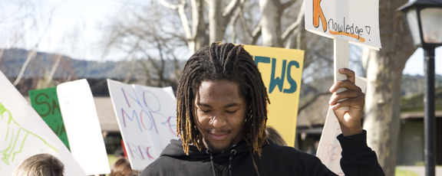
GOALS FOR OUR MEETING

Slide 4
NEXT STEPS
Establish a Writing Group
Set a Timeline with PaRC
Integrate equity goals into Program Review / Resource Requests

Slide 5
ESTABLISHING A WRITING GROUP
Tri-Chair Model
Invite Students to Participate
Tie into Core Mission Workgroups
Volunteers sought for Summer

Slide 6
TIMELINE
Need to set milestones
Have a new Student Equity Plan to PaRC by December 2013

Slide 7
INTEGRATE EQUITY GOALS
Student Equity theme for Opening Day 2013
Improve Equity Prompts for Program Review http://www.foothill.edu/staff/irs/programplans/index.php
Modify Resource Allocation Rubric http://www.foothill.edu/president/minutes/parc2012-13/parc011613/OPC_resource_rubric_with_criteria_2013_Draft_2_notracking_Item%204c.pdf

Slide 8
EQUITY WEBPAGE
A Webpage with all presentations, and resource links is now on the President’s Website.
www.foothill.edu/president/equity

Slide 9
THE WORK CONTINUES

