Slide 1
STUDENT EQUITY: A PLAN FOR ACTION
Planning Meeting
May 23, 2013

Slide 2
INTRODUCTIONS

Slide 3
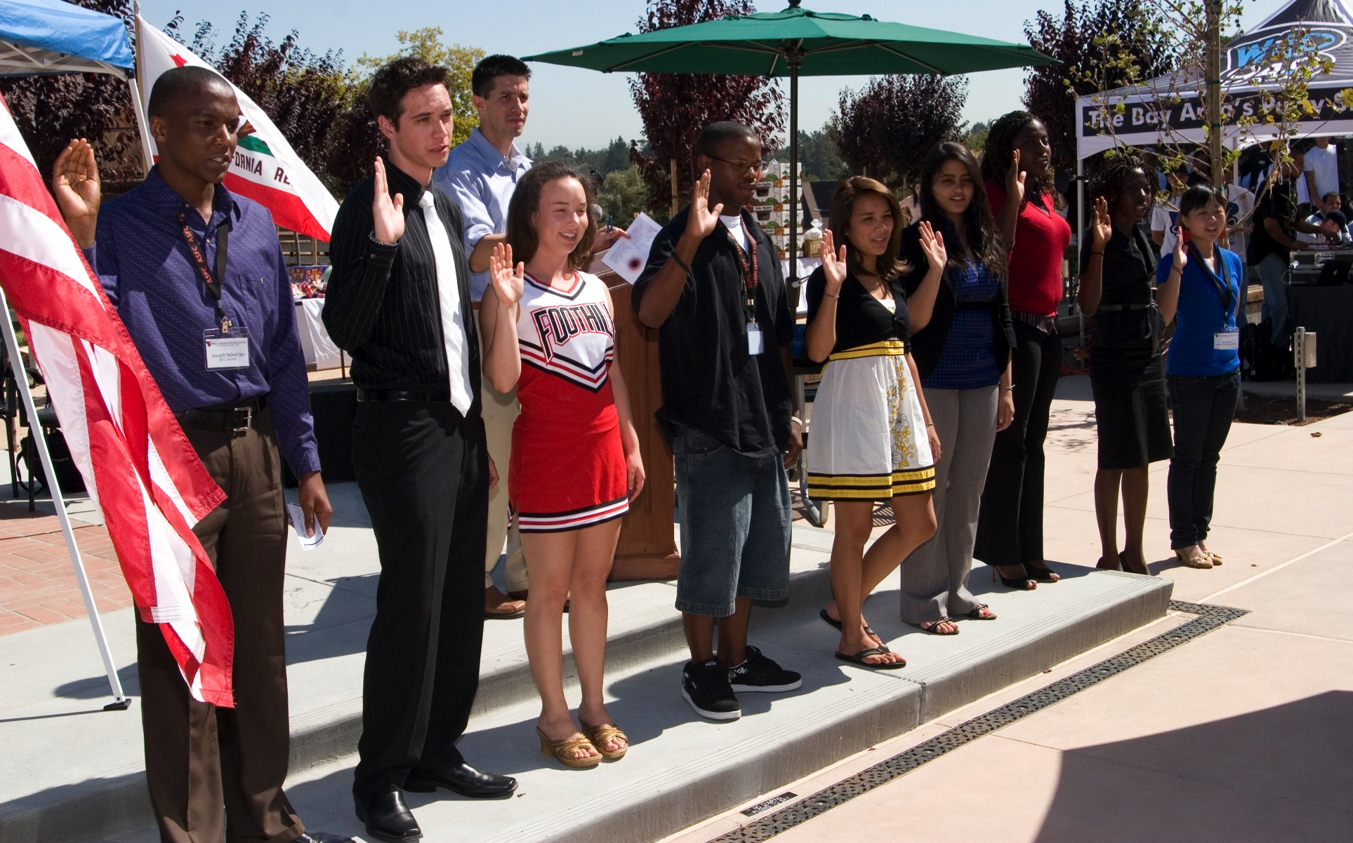
GOALS FOR OUR MEETING

Slide 4
TODAY WE WILL:
Reach consensus on populations to be targeted for increasing participation and success
Identify key research questions that will inform action plans
Propose a timeline for PaRC to oversee broad input and adopt of a Student Equity Plan

Slide 5
BACKGROUND
Judy Miner

Slide 6
ACTIONS TO DATE
Review of 2010 Student Equity Plan
Equity priorities added to12-13 program review prompts
Interviews with representatives of target populations
Substantive institutional research presentations to shared governance
Selection of student equity as Fall 13 Opening Day theme
Charge to Professional Development Committee for an equity strand in 13-14 programming

Slide 7
EMERGING THEMES
Mia Casey

Slide 8
KEY THEMES
FOR STUDENTS:
FOR FACULTY/STAFF:
More Orientations
Develop Cohorts
Mentor/Mentee
Establishing
Connections
Campus Conversations
Reconnect the Campus
Rebuild Morale
Life skills/Time management
How to Navigate the System
Bigger picture planning
Improving
Skills
Training for specific populations
Inform/build sensitivity to needs
Professional Development
Financial Support
Internship programs
Understanding Resources
Informing
More
Broadly
More detailed research data
Closer review of data
Better communication on decisions
Financial: Work v. School
Bus routes
Environment/Community
Mitigating
Resource
Impediments
Budget limitations
Time/Block Schedule
Decentralized Campus Layout
Mia Casey / Equity & Diversity Planning
March 19, 2013

Slide 9
INSTITUTIONAL GOALS
Equity is built into the Educational Strategic Master Plan (ESMP)
Goal:
Improve student outcomes, close the achievement gap, increase student success
Metrics:
Success rate of historically underserved student groups
Transfer Velocity Cohort Report
Certificates and degrees awarded to historically underserved student groups
Persistence rate by ethnicity

Slide 10
STUDENT DATA
Elaine Kuo

Slide 11
Total Enrollment
African American Enr.
Asian/Pac Isl Enr.
Filipino Enr.
Latino/a Enr.
White Enr.
Source: FHDA IR&P Fall Factsheets, 2007 to 2012
Notes:
The overall headcount of fall enrollments shows a relatively steady decline from 2007 to 2012 (-21%).
There was an increase in Latino (23%), African American (24%) and Filipino (27%) enrollment headcount.
The decline in student headcount is mainly due to decline in White (-30%) and Asian/P (-25%).
Decline in Whites and Asians noticed in Faculty (-10%) and Staff (-25%) headcounts.
However, the Admin headcount shows an increase (18%).
The increase headcount in Latino students’ enrollment mirrors the increase in Latino faculty (26%, the only faculty ethnicity that shows increase from 2007-2012).

Slide 12
Foothill College Fall 2007 to Fall 2012
Latino Enrollment with County and Service Area Overlay
County
Service Area
Source: FHDA IR&P, EMSI

Slide 13
Foothill College Fall 2007 to Fall 2012
African American Enrollment with
County and Service Area Overlay
Service Area
County
Source: FHDA IR&P, EMSI
Notes:
Remove other ethnicities
The percentage of African Americans in Santa Clara County and Foothill’s service area have both been consistent around 3%.
The percentage of African Americans enrolled in Foothill has slowly been increasing and is higher than the percentages found in the region.

Slide 14
Foothill College Fall 2007 to Fall 2012
Filipino Enrollment With County Overlay
County
Source: FHDA IR&P, EMSI
Notes:
Remove other ethnicities; focus on filipinos—perhaps include service area Filipino rate?
Student enrollment percentages for pacific Islander and native Americans is higher than the region
Percentage of Filipino students has increased but is still below that of the county

Slide 15
Foothill College 2011-2012
Awarded Financial Aid by Ethnicity
Foothill College 2011-2012
Financial Aid Status by Ethnicity
Source: FHDA IR&P

Slide 16
Source: FHDA IR&P

Slide 17
Foothill College Fall 2009 to Fall 2012 Course Success Rates by Ethnicity
Other/Unk n includes Native American, Other, Unknown and Decline to State.
Source: FHDA IR&P
African American and Latino/a experience course success at a lower rate compared to other groups.
FOOTHILL COLLEGE
Notes:
Pull out Filipino students
Work on formatting for consistency

Slide 18
Foothill College 2011-2012 Course Success Rates by Instructional Method and Ethnicity
Source: FHDA IR&P
All students, regardless of ethnicity, appear to experience success at a lower rate in online courses.
FOOTHILL COLLEGE
Notes:
Slide with gender?
Work on formatting for consistency

Slide 19
2013 Student Success Scorecard
Foothill College
Basic Skills Education Progress
Who’s in the cohort?
Attempt a credit course below transfer level
What’s the cohort outcome?
Math: pass a college-level Math course within 6 years (includes degree and transfer applicable)
English: pass a college-level English course within 6 years
ESL: pass the ESL sequence or a college-level English within 6 years
FOOTHILL COLLEGE

Slide 20
Math
2002-2003 to 2006-2007 Cohorts
Who’s being counted at FH in 2006-07?
91 Whites
17 Filipinos
What’s being counted in 2006-07?
87 Latino/as
16 Asians
Mainly Math My Way
Over 40% of cohort
29 African Americans
Total 281
Cohort size decreased from a high of 424 students in 2002-03
FH Asian
FH White
FH Latino
Foothill
State
FH Filipino
FH African American
Note: What was being coded as basic skills (CB21) during this period affects what’s being counted at the state level. For example, Math 220 was not coded as CB21.
FOOTHILL COLLEGE
Source: 2013 Student Success Scorecard
Notes:
After April revise from state:
2006-07 cohort includes:
Data does not include Native Americans, Pacific Islanders, Other/Unknown

Slide 21
English
2002-2003 to 2006 to 2007 Cohorts
What’s being counted at FH in 2006-07?
Mainly English 100 as well as 104 A/B, 205 and 215
FH White
FH Filipino
FH Latino
Foothill
FH Asian
FH African American
State
Who’s being counted at FH in 2006-07?
Total 500
157 Whites
55 African Americans
26 Filipinos
142 Latino/as
52 Asians
25 Pacific Islanders
Cohort size has decreased steadily from 905 in 2002-03
Note: What was being coded as basic skills (CB21) during this period affects what’s being counted at the state level.
FOOTHILL COLLEGE
Source: 2013 Student Success Scorecard

Slide 22
ESLL
2002-2003 to 2006-2007 Cohorts
Who’s being counted at FH in 2006-07?
Total 365
148 Asian
52 White
2 Filipino
134 Latino/a
4 African American
2 Pacific Islander
ESL cohort size has decreased from a high of 578 in 2002-03
FH Asian
Foothill
FH Latino/a
State
What’s being counted at FH in 2006-07?
Seems like about 45% in F06 are enrolled in ESL 166/167, 155/156
Note: What was being coded as basic skills (CB21) during this period affects what’s being counted at the state level.
FOOTHILL COLLEGE
Source: 2013 Student Success Scorecard

Slide 23
THE WORK CONTINUES

